Slide 1

PRODUCT CATALOGUE

Slide 2
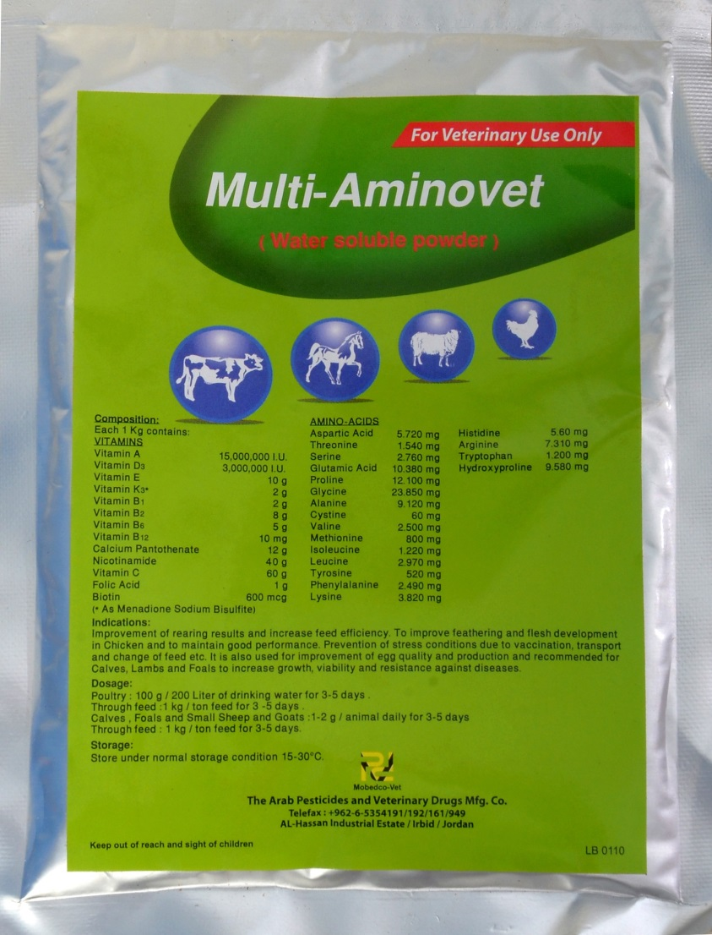

Multi- Aminovet: 100g or 500g
Indications: Boosting growth, immunity, feed conversion, egg production, stress relief and treatment of vitamin deficiencies in poultry
Dosage:10gms(1table spoon)in 20liters of water
for 3-5days

Slide 3
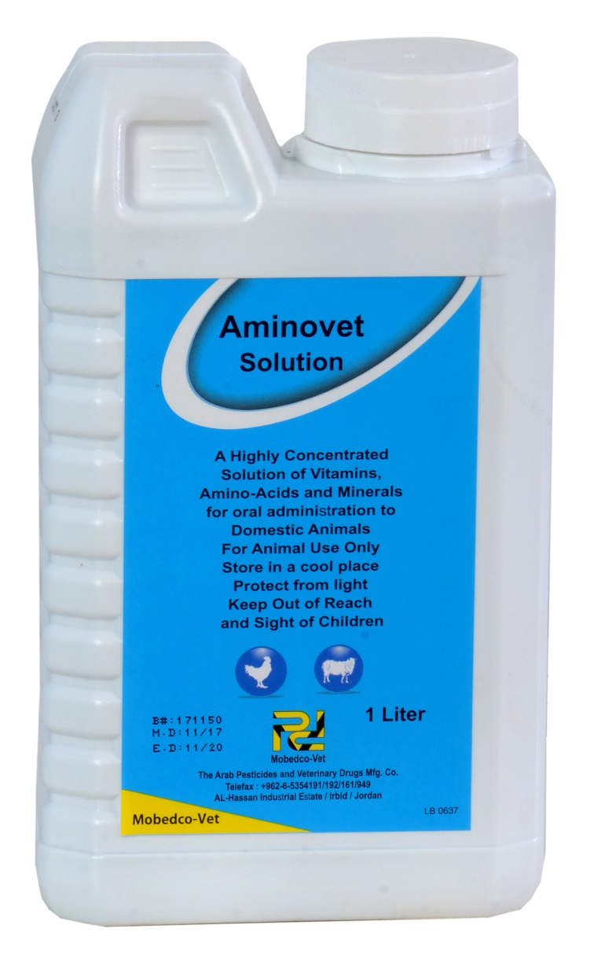
Aminovet solution
Indications:
Boosting growth, immunity, feed conversion, egg production and treatment of vitamin deficiencies in poultry
Dosage: 5mls in 20liters of water

Slide 4
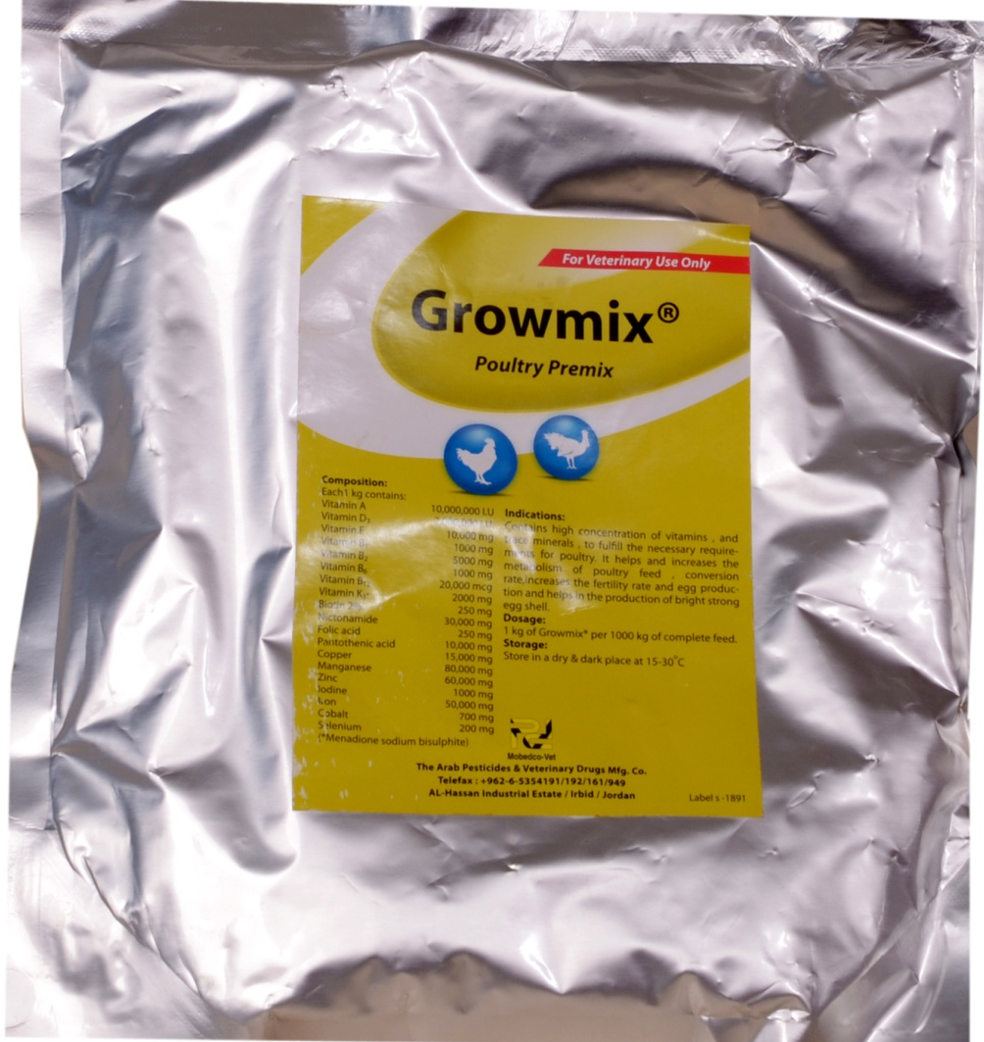
Growmix® poultry premix
General purpose premix for poultry
Indications: Improvement of metabolism, electrolyte balance, fertility and egg production and quality.
Inclusion rate:100g in 100kgs or 1kg in 1tonne of complete feed.

Slide 5
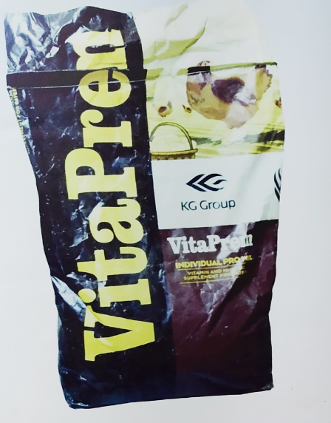
Vitaprem premix for layers
High quality premix for layers containing vitamins, amino acids and minerals at optimum physiological levels.
Indications: Improvement of metabolism, electrolyte balance, fertility and egg production and quality.

Slide 6
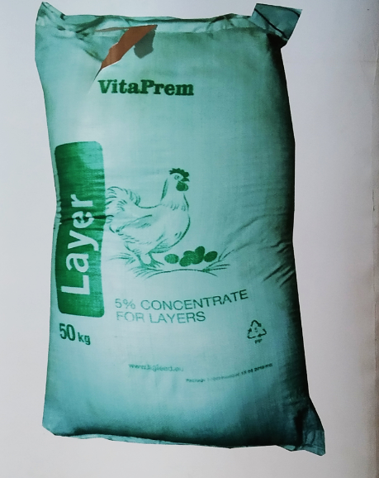
Vitaprem 5% concentrate for layers
High quality concentrate for layers fortified with vitamins, minerals and enzymes required for stable egg production, good egg quality and size plus strengthening immunity
Indications: Improvement of metabolism, electrolyte balance, fertility and egg production and quality.

Slide 7
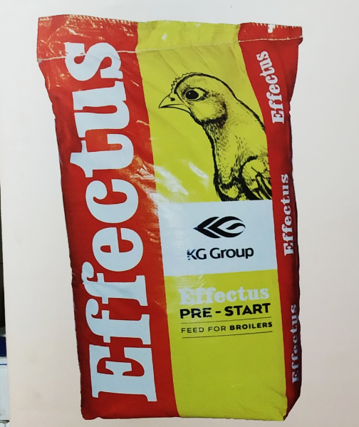
Effectus pre-start feed for broilers
Broiler feed made from selected high quality feed raw materials with optimum minerals, vitamins, amino acids and energy levels.
Also fortified with phytase enzymes and antioxidants

Slide 8
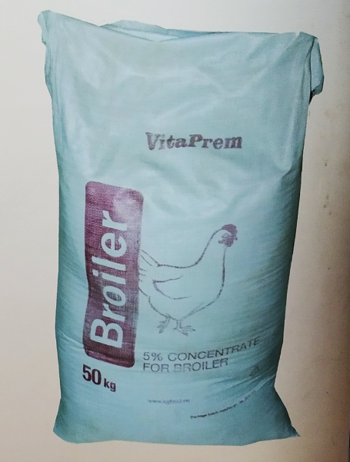
Vitaprem 5% concentrate for broilers
For fast growth and early attainment of competitive market weights for broilers

Slide 9
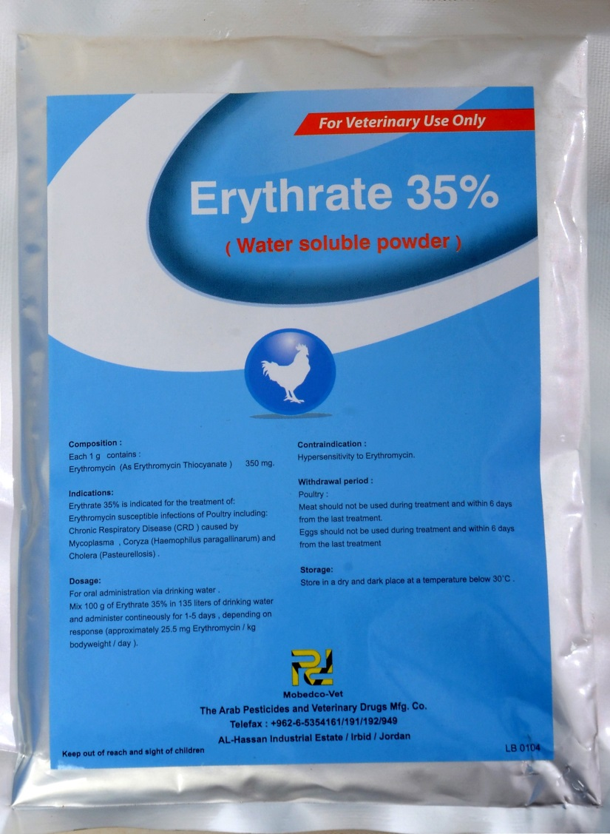
Erythrate35% (Erythromycin thiocyanate)
Indications:
Treatment of respiratory tract infections caused by bacteria including mycoplasma(CRD)
Dosage: 20gms in 20liters of water for 5 consecutive days.

Slide 10
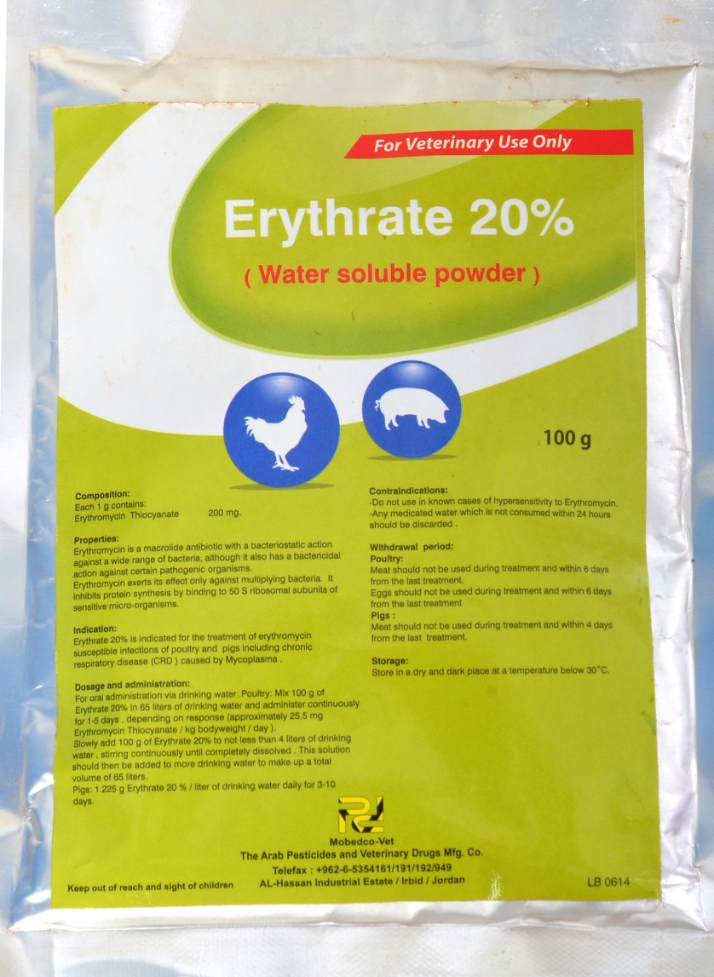
Erythrate20% (Erythromycin thiocyanate)
Indications:
Treatment of respiratory tract infections caused by bacteria and mycoplasma(CRD)
Dosage: 30gms in 20liters of water for 5 consecutive days

Slide 11
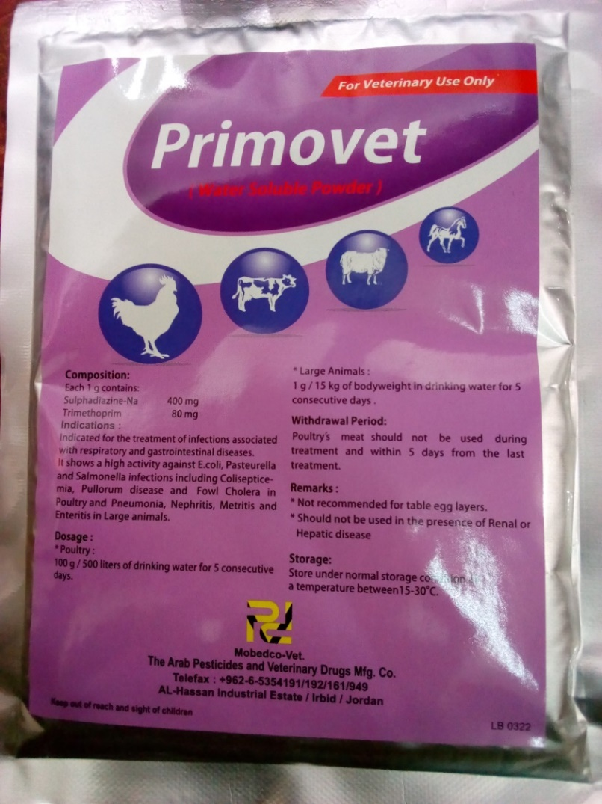
Primovet (Sulphadiazine-Na & Trimethoprim combination)
Indications:
Treatment of respiratory & gastrointestinal diseases due to E.coli, Pasteurella, salmonella and coccidiosis infections
Therapeutic dosage in poultry: 10gms in 20liters of water for 5 consecutive days.

Slide 12
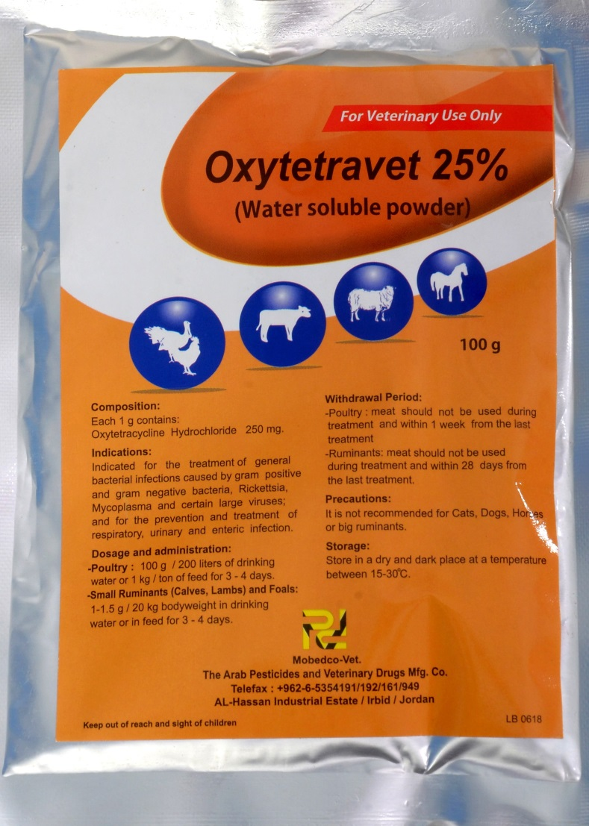
Oxytetravet 25% (Oxytetracycline 25%): 100g or 500g
Indications: Treatment of septicemia, respiratory, urinary, enteric and other infections caused by gram positive and gram negative bacteria, rickettsia and mycoplasma.
Dosage:
10gms in 20liters of water for 5 days

Slide 13
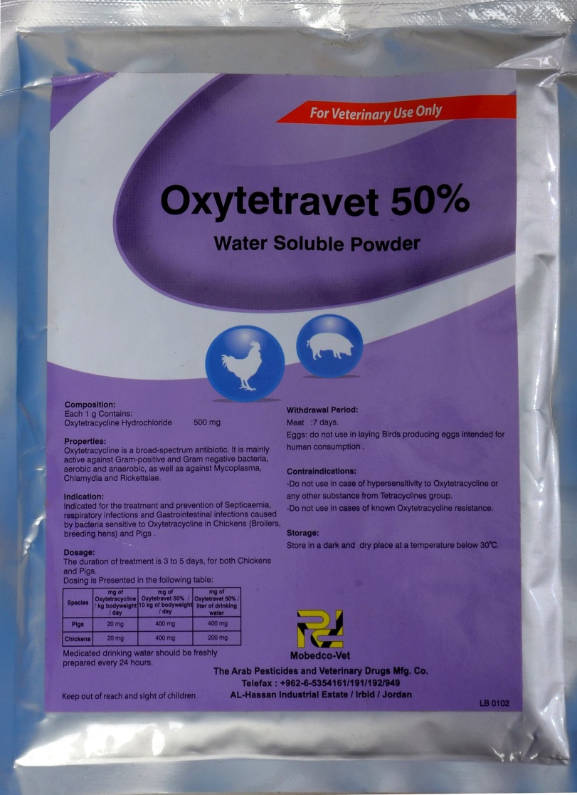
Oytetravet50% Oxytetracycline hydrochloride
Indications:
Treatment and prevention of septicemia, respiratory infections and gastrointestinal bacterial infections in chicken and pigs
Dosage: 10gms in 20liters of water for 5 days

Slide 14
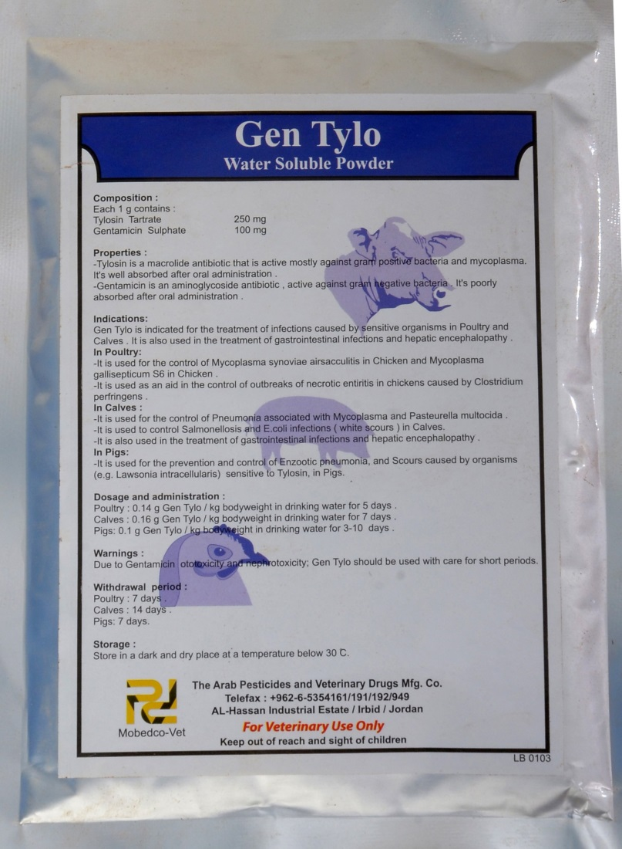
Gen Tylo ( Gentamicin sulphate + Tylosin tartrate)
Indications:
Treatment of a wide range of respiratory, enteric and urinary tract infections of bacterial origin.
Dosage:
20gms in 20liters of water for 5days consecutive days.

Slide 15
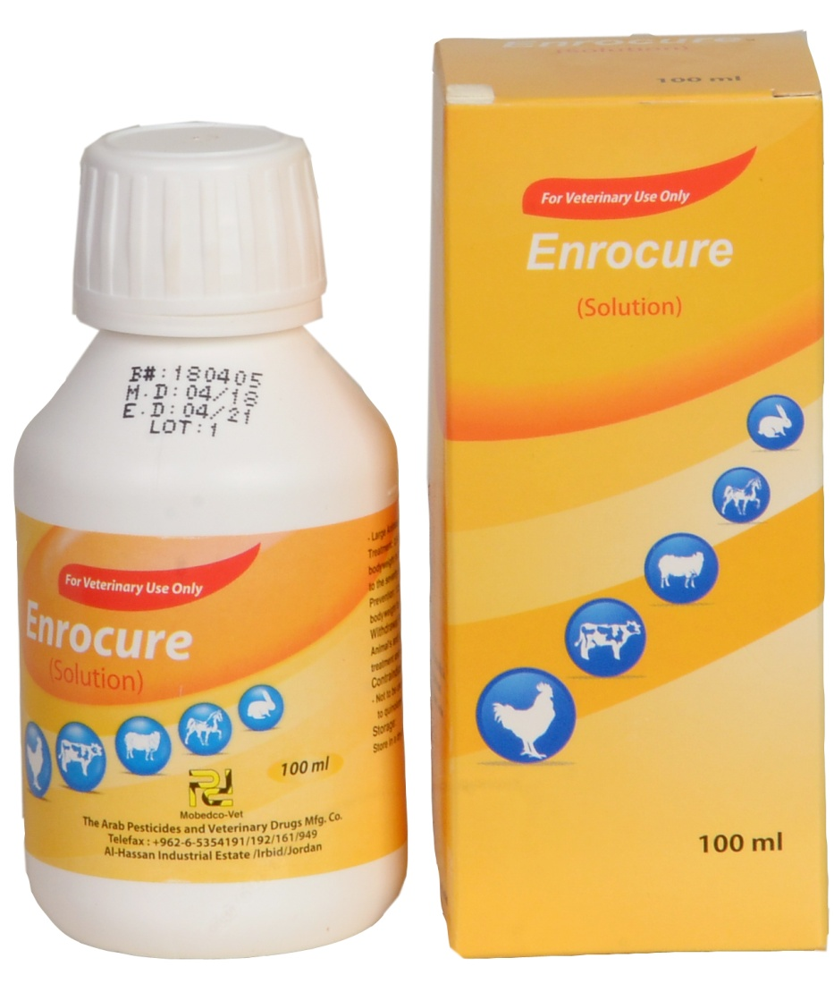
Enrocure Solution Enrofloxacin: (100ml, 500ml or 1liter)
Indications: Treatment and prevention of respiratory, enteric and urinary tract bacterial infections in poultry and other species.
Effective therapeutic dosage: 20mls in 20liters of water for 3-5days
Packaging: 100ml, 500ml and 1liter

Slide 16
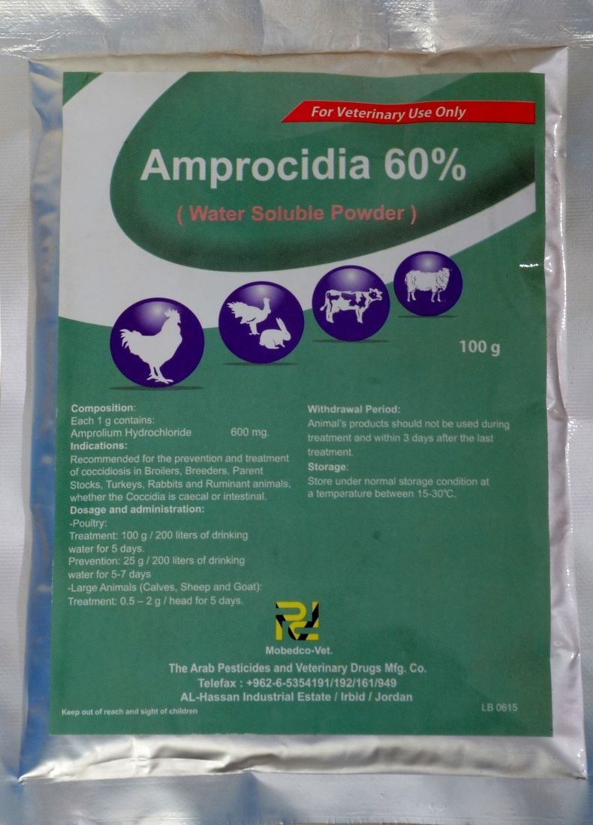
Amprocidia60%® ( Amprolium Hydrochloride)
Indications: Prevention and treatment of coccidiosis in poultry and other species
Dosage in poultry:
10gms in 20liters for 5 consecutive days.

Slide 17
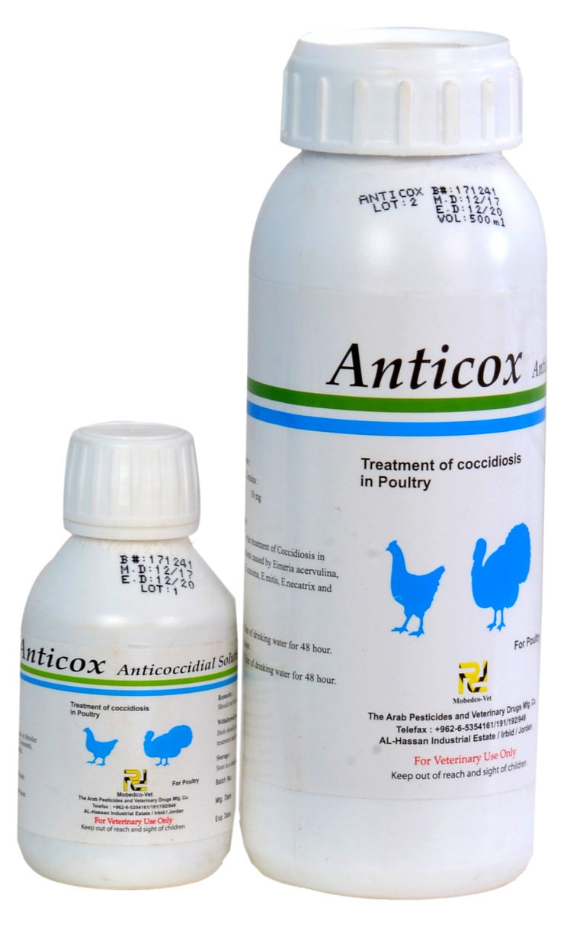
Anticox® Diclazuril – Anticoccidial solution
Indication: Treatment of coccidiosis in poultry
Therapeutic dosage: 10mls in 20liters of water for 3days.

Slide 18
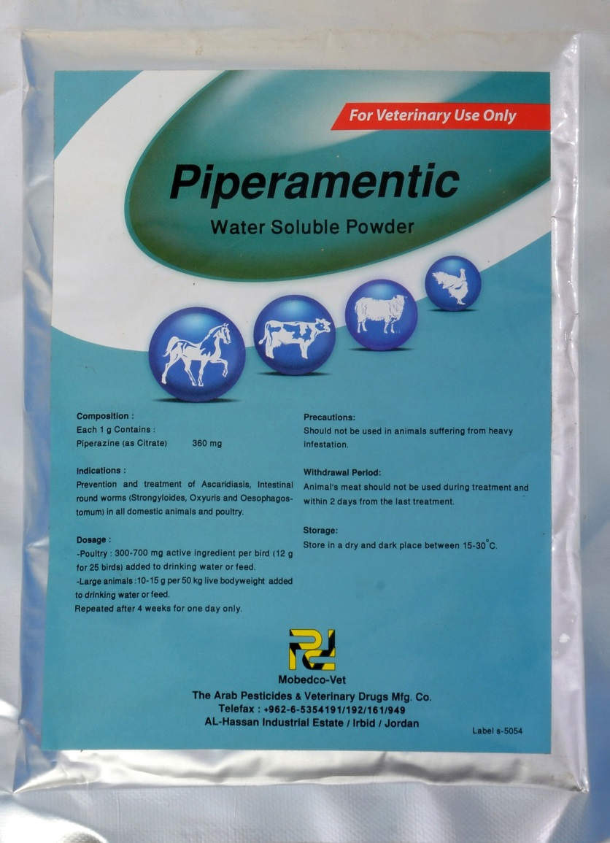
Piperamentic Piperazine as a citrate: (100g or 500g)
Indications:
Broad spectrum dewormer for prevention and treatment of Ascaridiasis, and other round worms in all large animals and poultry
Dosage for poultry: 40gms in 20liters of water for 1day

Slide 19
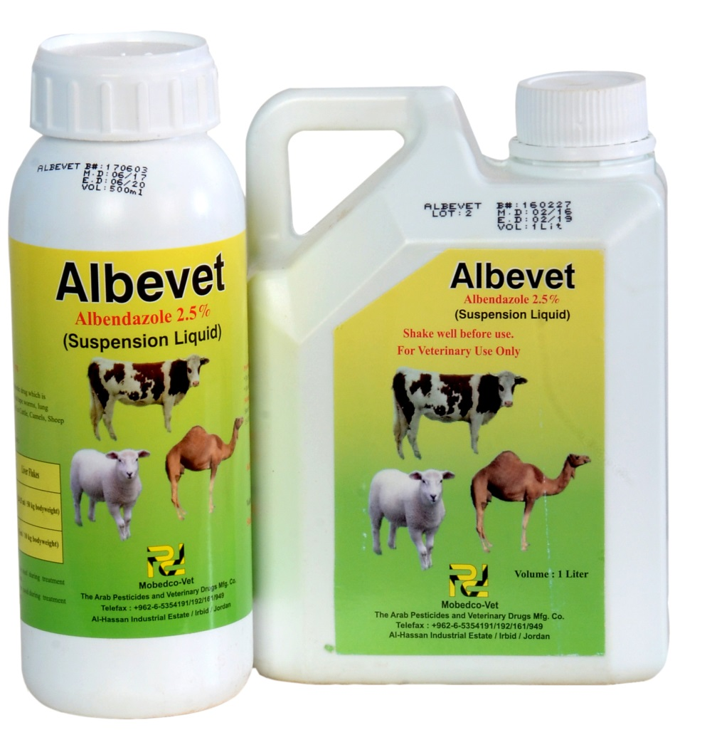
Albevet2.5% (Albendazole2.5% oral suspension)
Description and indications
Broad spectrum dewormer against Nematodes, flukes and tapeworms in domestic animals

Slide 20
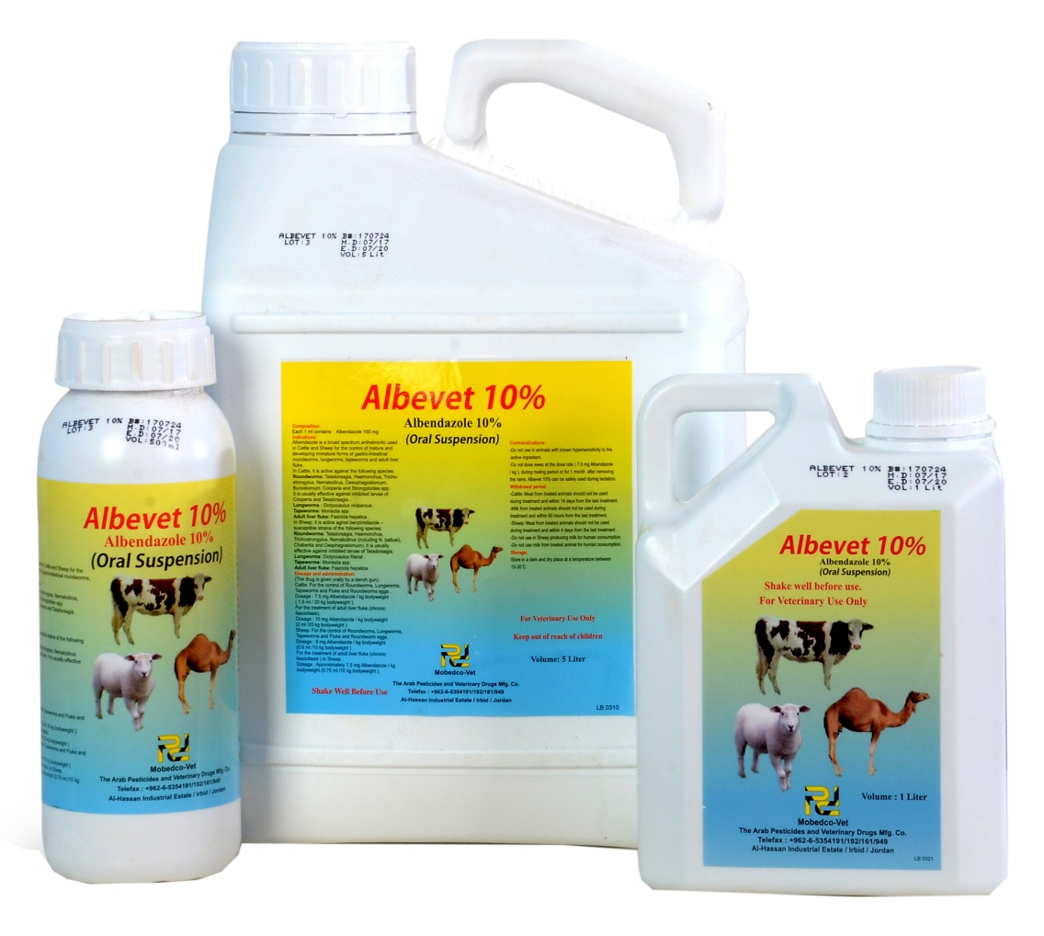
ALBEVET10% (Albendazole10% oral suspension)
Description and indications
Broad spectrum dewormer against Nematodes, flukes and tapeworms in domestic animals

Slide 21
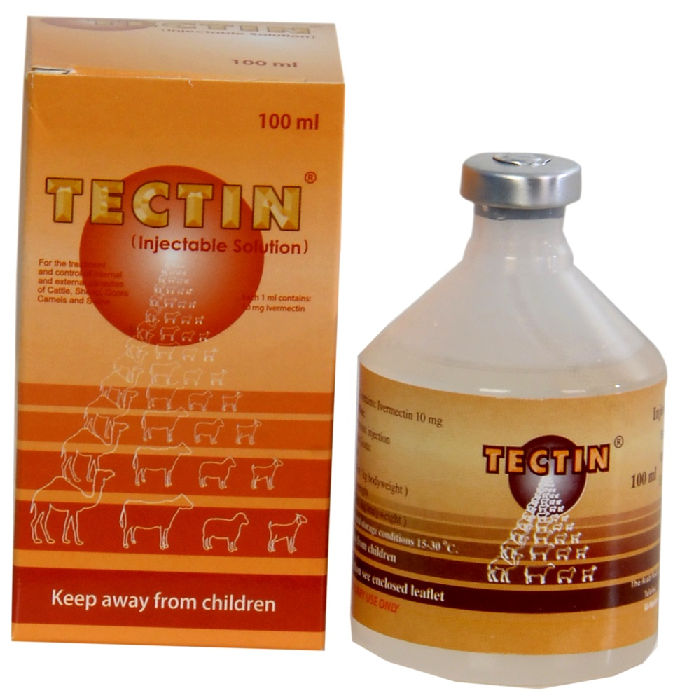
TECTIN® ( Injectable (Ivermectin1% Injectable solution)
Indications
For treatment of helminthosis, mange and other ectoparasite infestations /or infections.
Packaging: 50ml and 100ml

Slide 22
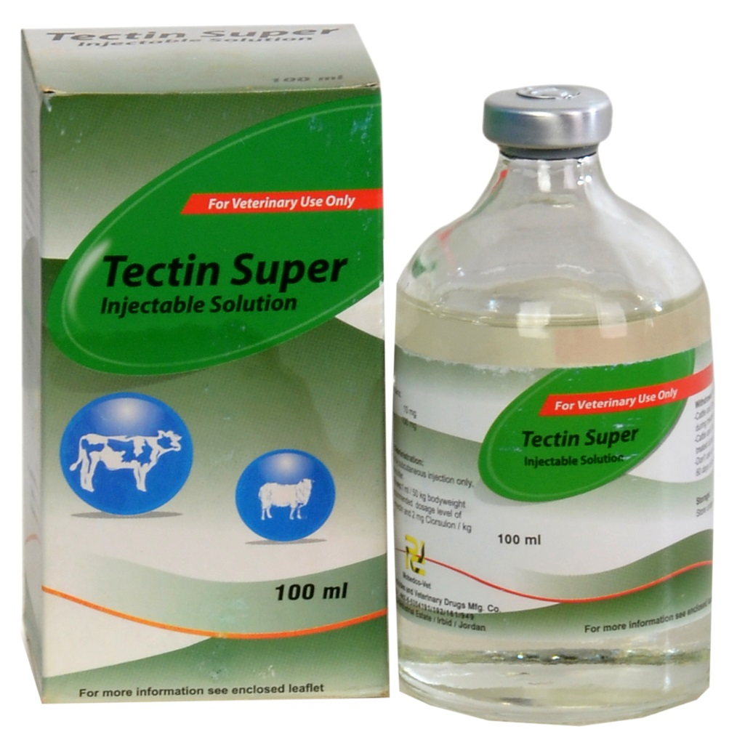
TECTIN SUPER Ivermectin & Clorsulon: 50ml or 100ml
Indications:
Treatment and prevention of gastrointestinal and lung nematodes, liver flukes, warbles, eye worms, mites and lice of beef and non-lactating cattle and shoats.
Dosage in cattle and sheep: 1ml/50kg body weight

Slide 23
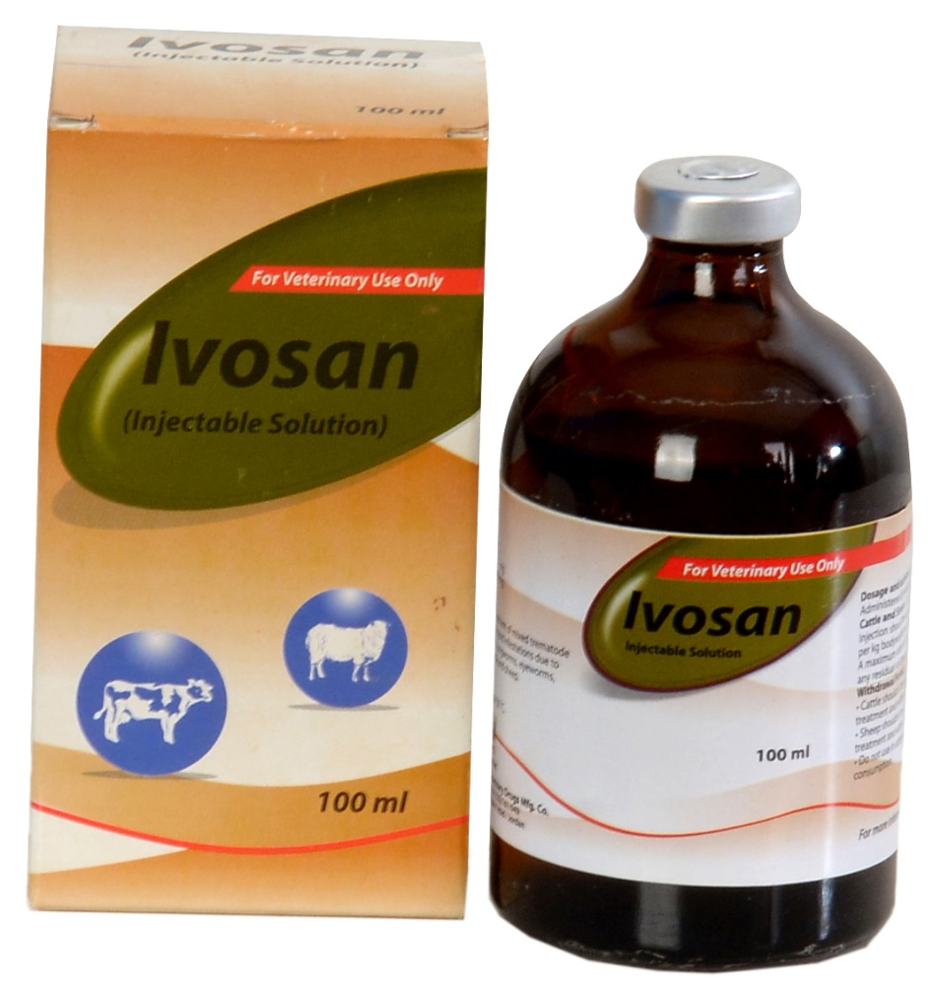
Ivosan (Ivermectin & Closantel)
Indications:
Treatment of roundworm and fluke infestation in cattle and shoats.
Dosage: 1ml/25kg live body weight

Slide 24
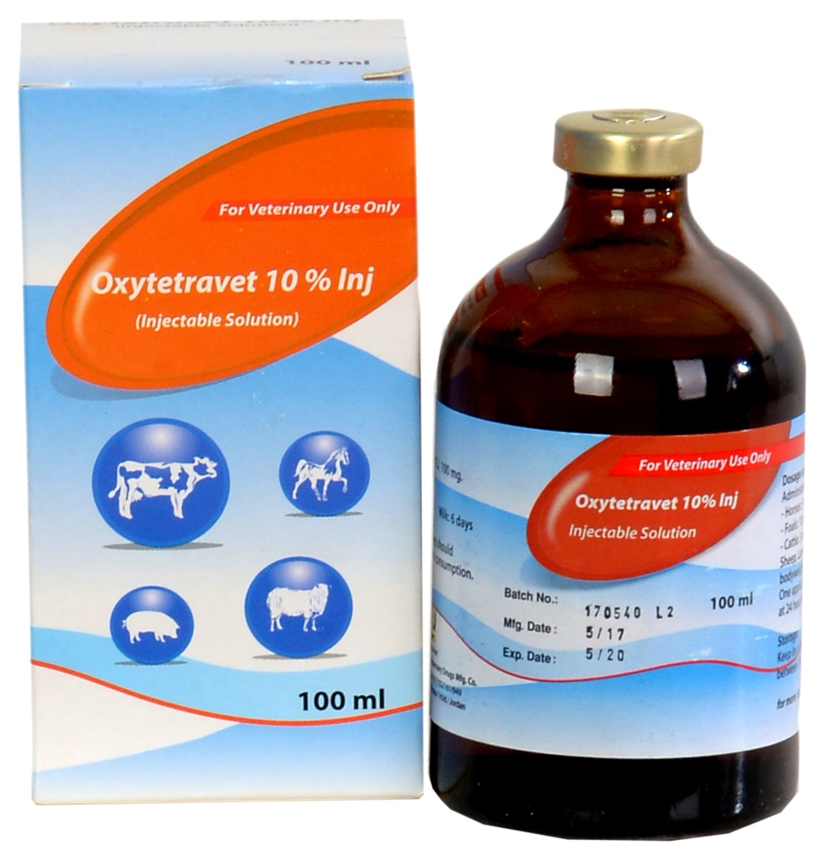
Oxytetravet10% Inj Oxytetracycline (as hydrochloride)
Indications
For treatment of infections caused by organisms sensitive to Oxytetracycline in Horses, Cattle, Goats, sheep and pigs
Dosage: 1ml per 10kg body weight

Slide 25
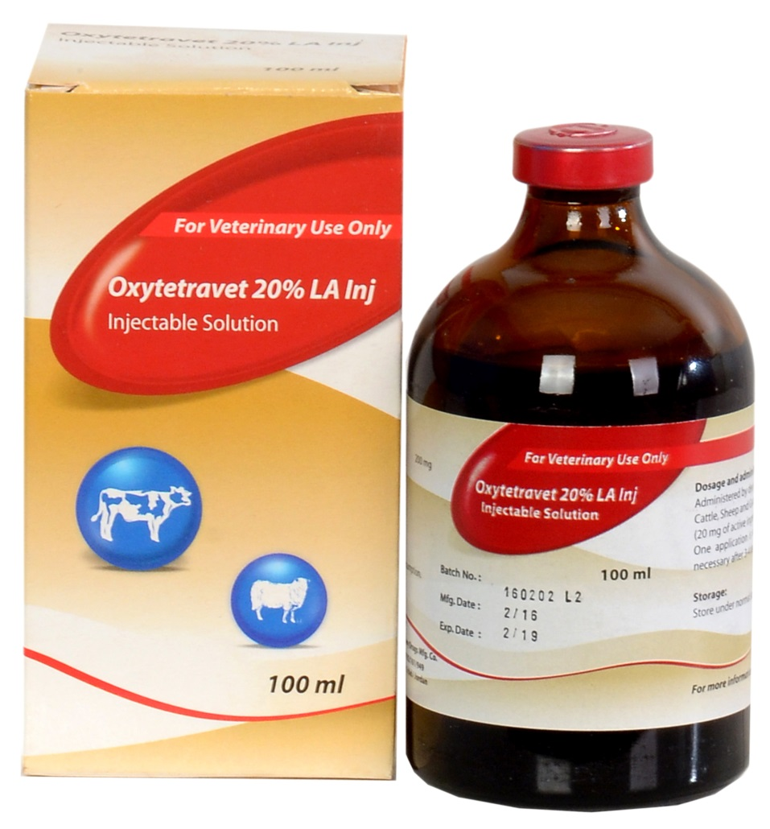
Oxytetravet 20% LA Inj Oxytetracycline (as hydrochloride)
Long acting antibiotic for treatment and control of a wide range of diseases in cattle, sheep and goats e.g. respiratory tract infections, navel/joint ill, mastitis, septicemia, etc.

Slide 26
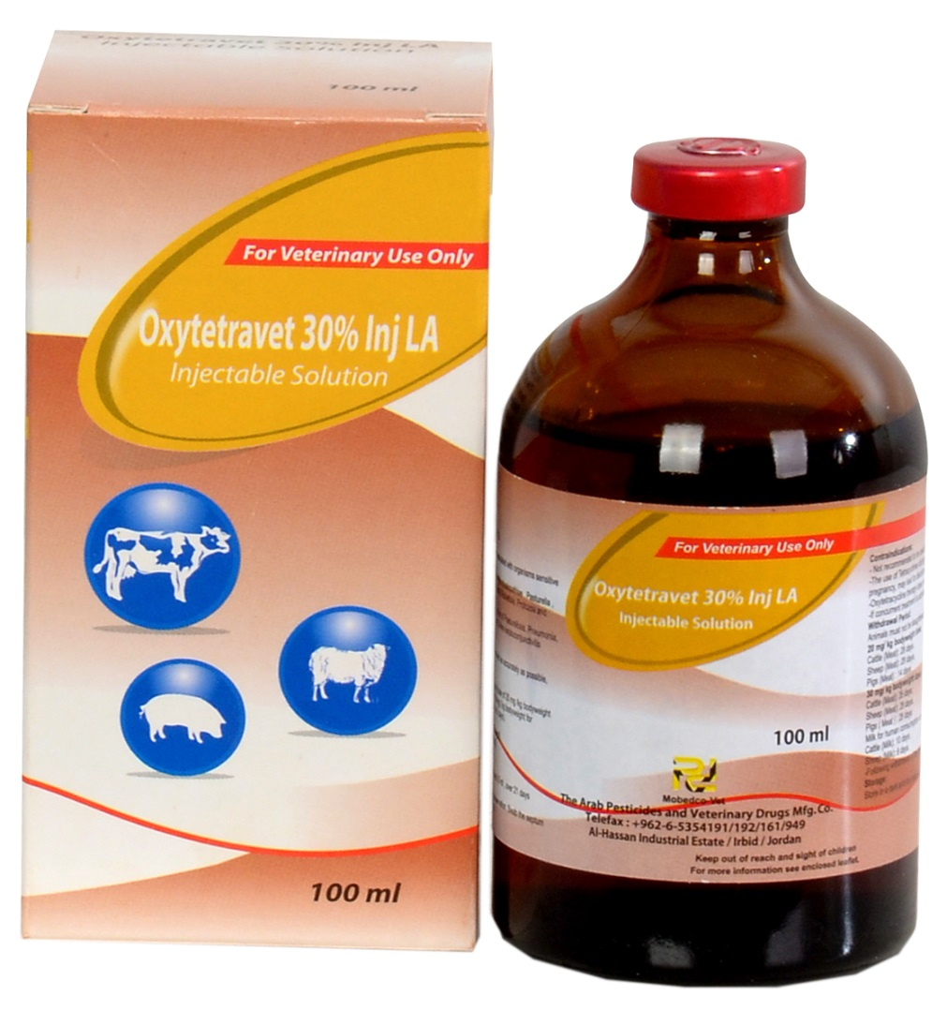
Oxytetravet30% Inj LA (As Oxytetracycline Dihydrate)
Antibiotic with a prolonged and sustained activity against a wide range bacterial infections
E.g. pasteurellosis, pneumonia, atrophic rhinitis, pink eye, navel/joint ill, mastitis, pink eye, enzootic abortion in sheep etc

Slide 27
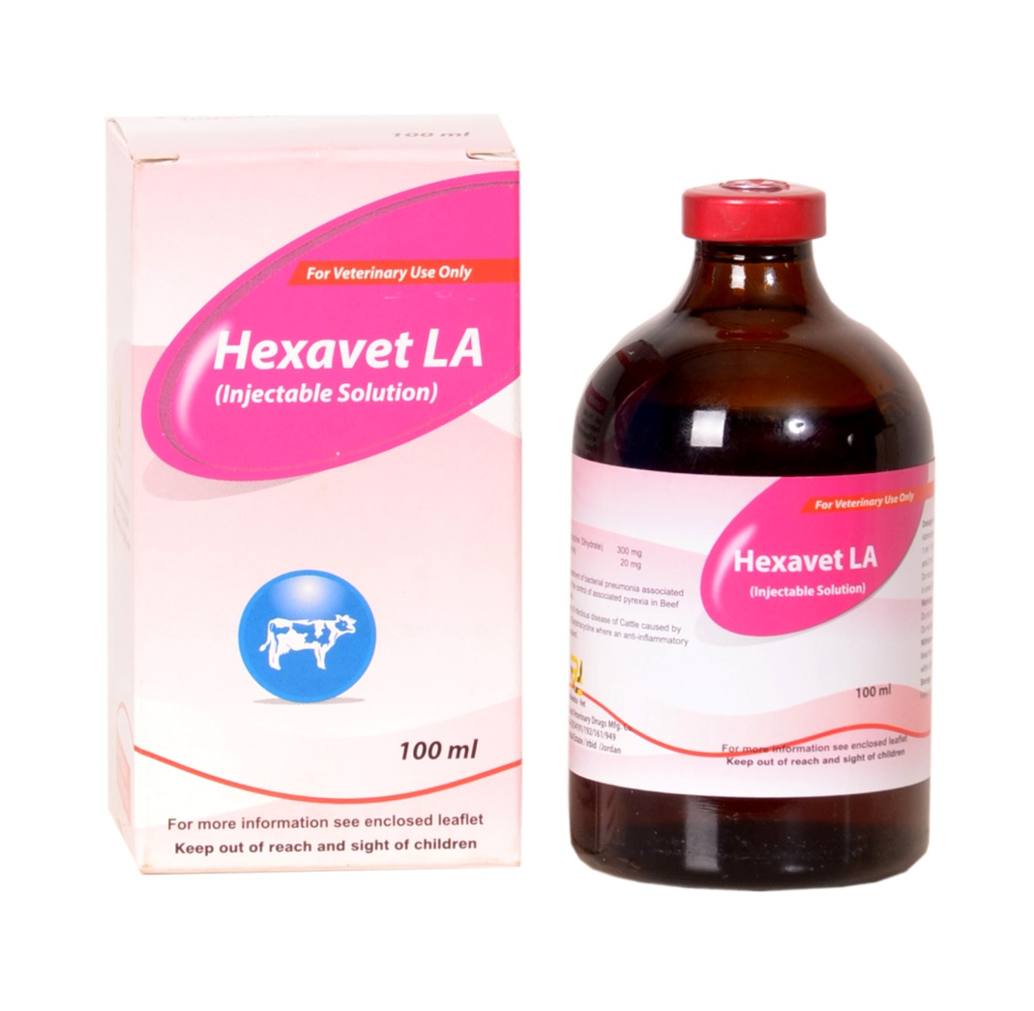

Hexavet LA (Injectable solution) Oxytetracycline as Oxytetracycline Dihydrate……300mg Flunixin as Flunixin meglumine………………….20mg
Properties
Hexavet LA is a broad spectrum long acting antibiotic (Oxytetracycline Dihydrate) and non-steroidal anti-inflammatory drug(flunixin meglumine) Injectable solution.
Indications
For treatment of bacterial pneumonia and other infectious diseases of domestic animals where anti-inflammatory and antipyretic effects are required.
Dosage and administration
Administered by intramuscular injection only at a dosage rate of 1ml per 10kg body weight

Slide 28
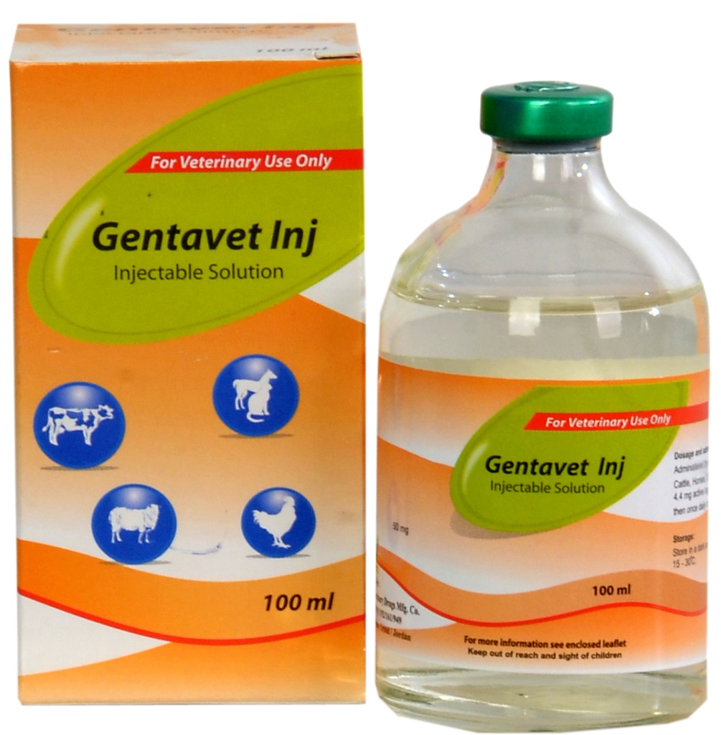
Gentavet Inj Gentamicin (As sulphate) 50mg
Indications: Treatment of urinary, respiratory and reproductive tract infections. And infections of the skin and soft tissues
Dosage: 1ml/10kg twice daily for 1day and then once daily for 3-4days

Slide 29
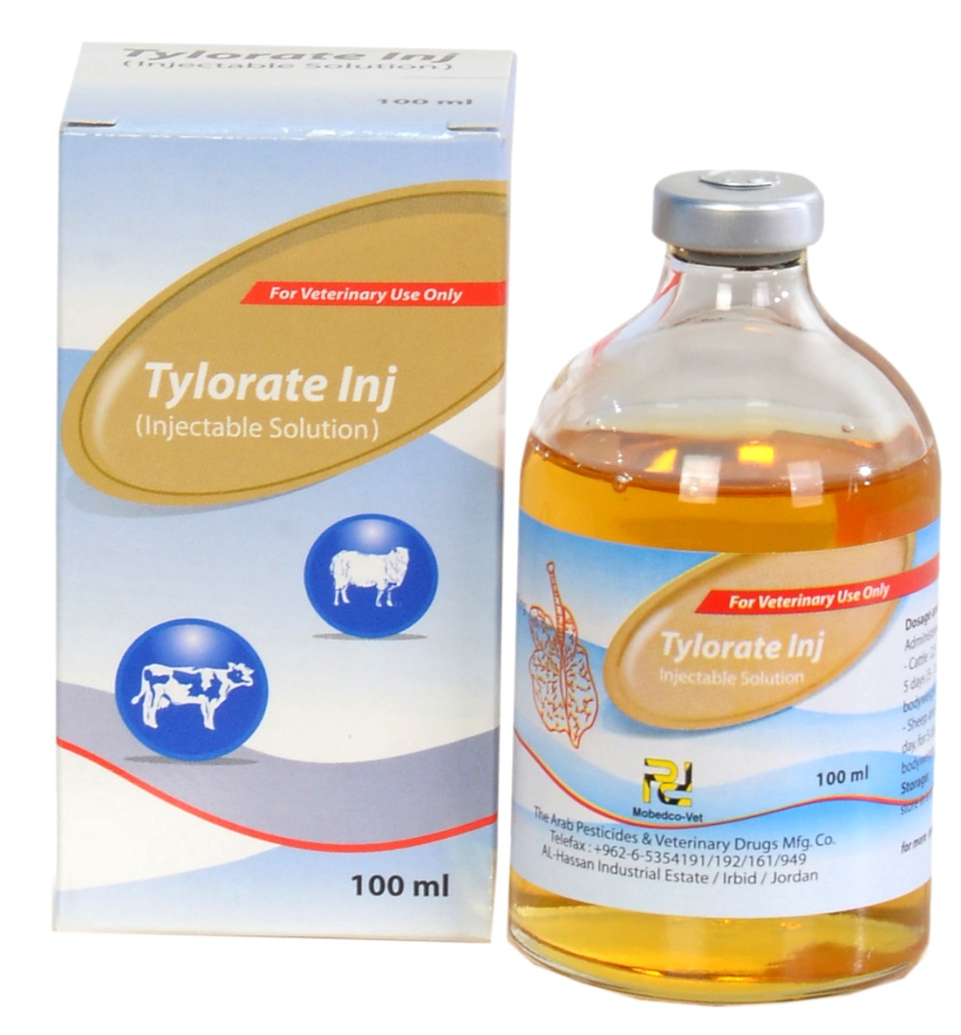
Tylorate Inj Tylosin (as tartrate) 200mg
Indications:
Indicated in treatment of respiratory conditions including CBPP/CCPP caused by mycoplama spp.

Slide 30
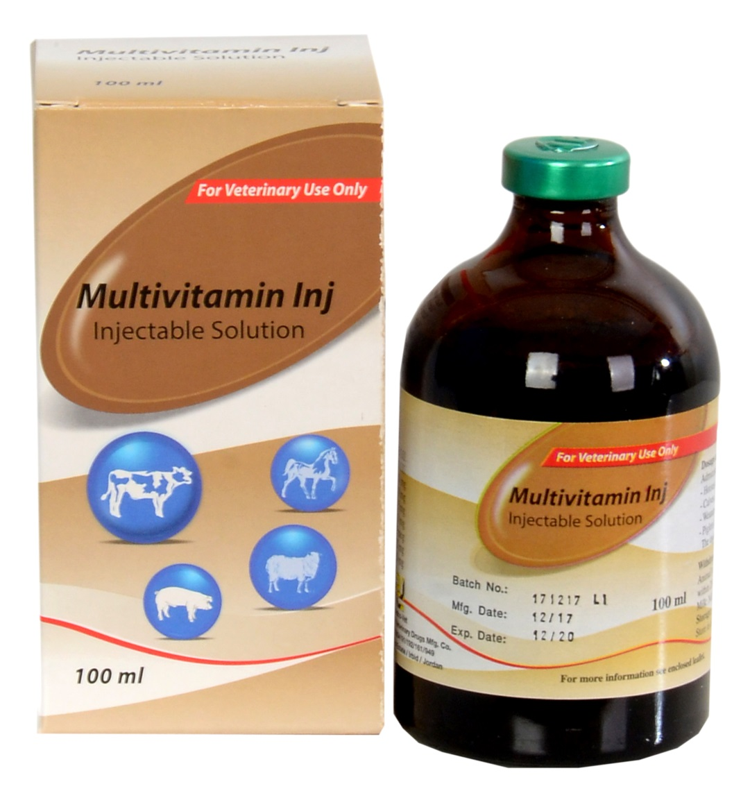
Multivitamin Inj (Injectable solution)
Indications:
For prevention and treatment of vitamin deficiencies in animals
Boosts feed conversion and metabolism, growth rate and fertility in animals

Slide 31
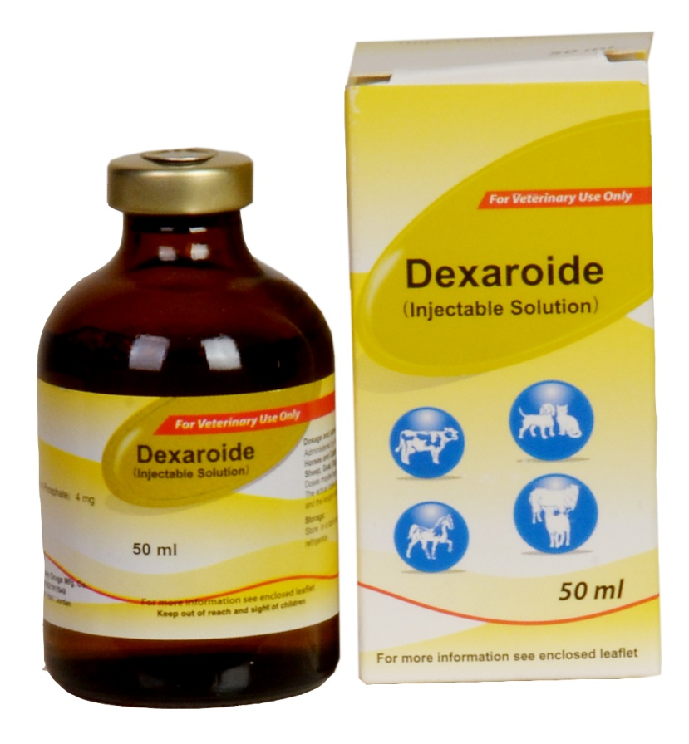
Dexaroide (Dexamethasone Na-phosphate)
Indications: Treatment of ketosis and acetonemia, shock conditions, allergies and a wide range of inflammatory conditions.
Contraindicated in pregnant animals

Slide 32
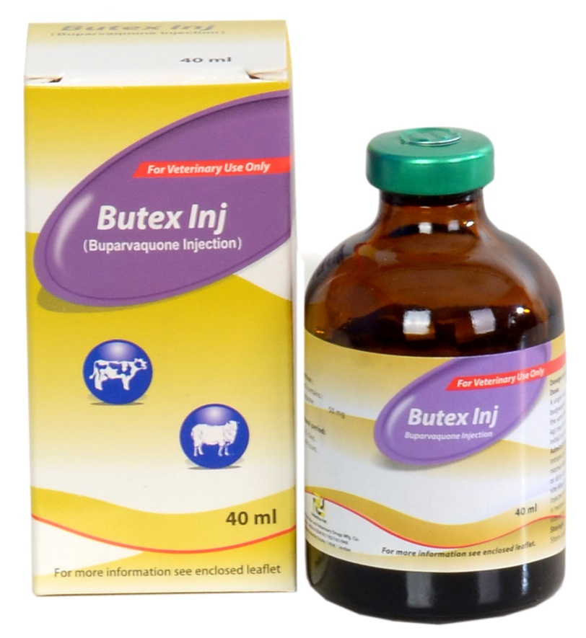
Butex Inj (Buparvaquone injection)
Indications:
Treatment of Theireliosis( East coast fever, Corridor disease, Tropical theireliosis etc) in cattle
Dosage: 1ml/20kg body weight

Slide 33
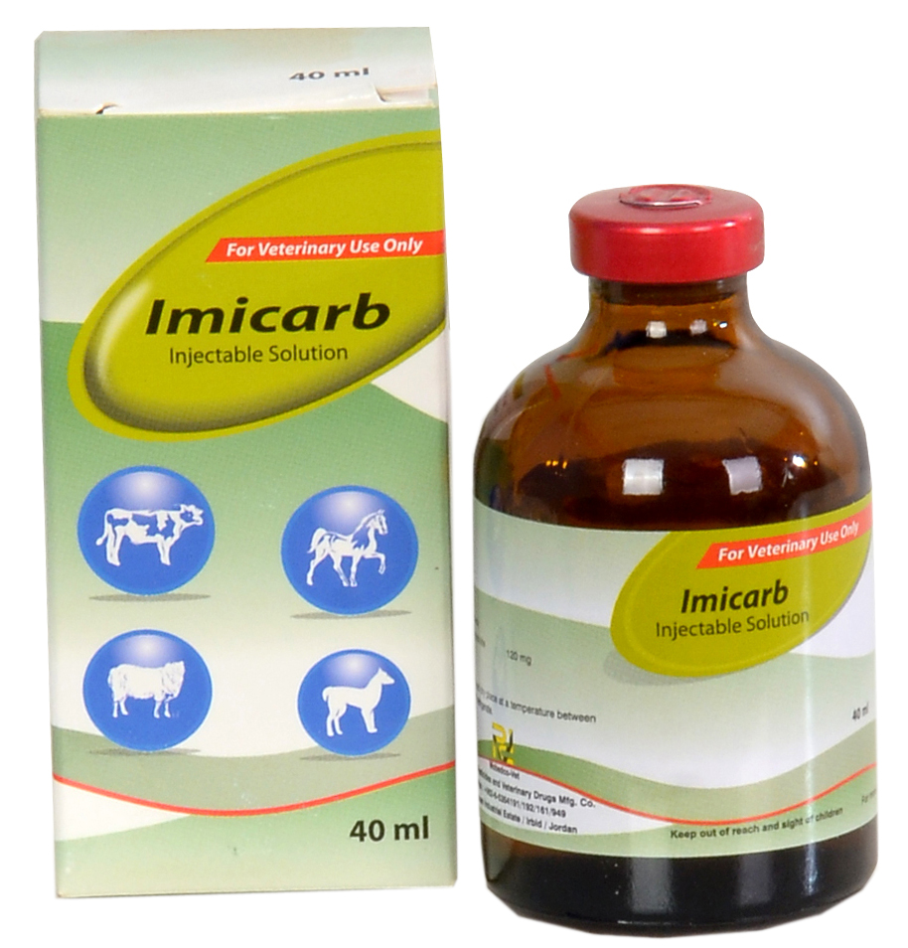
Imicarb® (Imicarb Dipropionate)
For treatment of:
Babesiosis in cattle, Horses and dogs,
Anaplasmosis in cattle and canine Ehrlichiosis

Slide 34
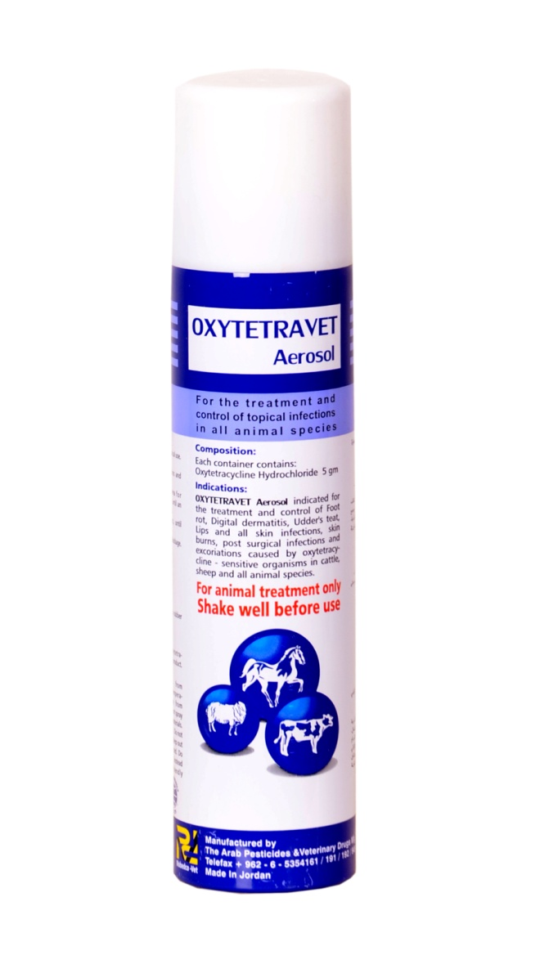
Oytetravet aerosol
Description and indications:
Contains Oxytetracycline and a purple dye for treatment of wounds in animals as well as repelling contaminative flies.

Slide 35
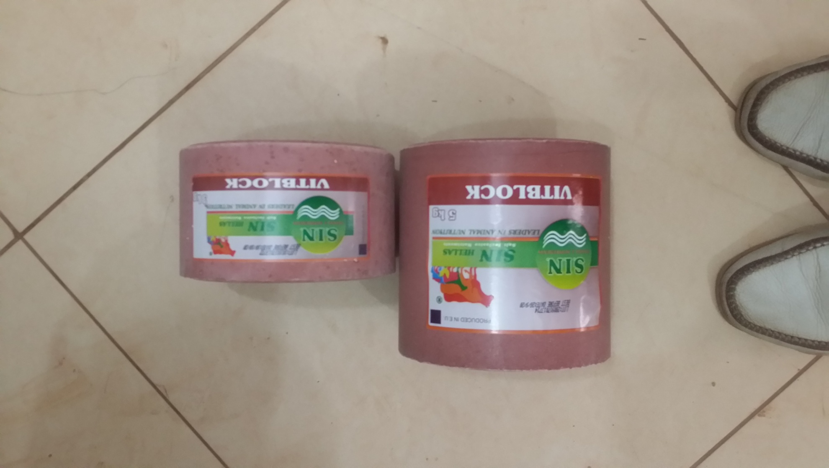
VITBLOCK
Highly nutritious mineral lick enriched will with minerals and vitamins. Indicated for prevention and treatment of electrolyte and vitamin deficiencies in domestic animals, for fattening and immune boosting.

Slide 36
POULTRY VACCINES

Slide 37
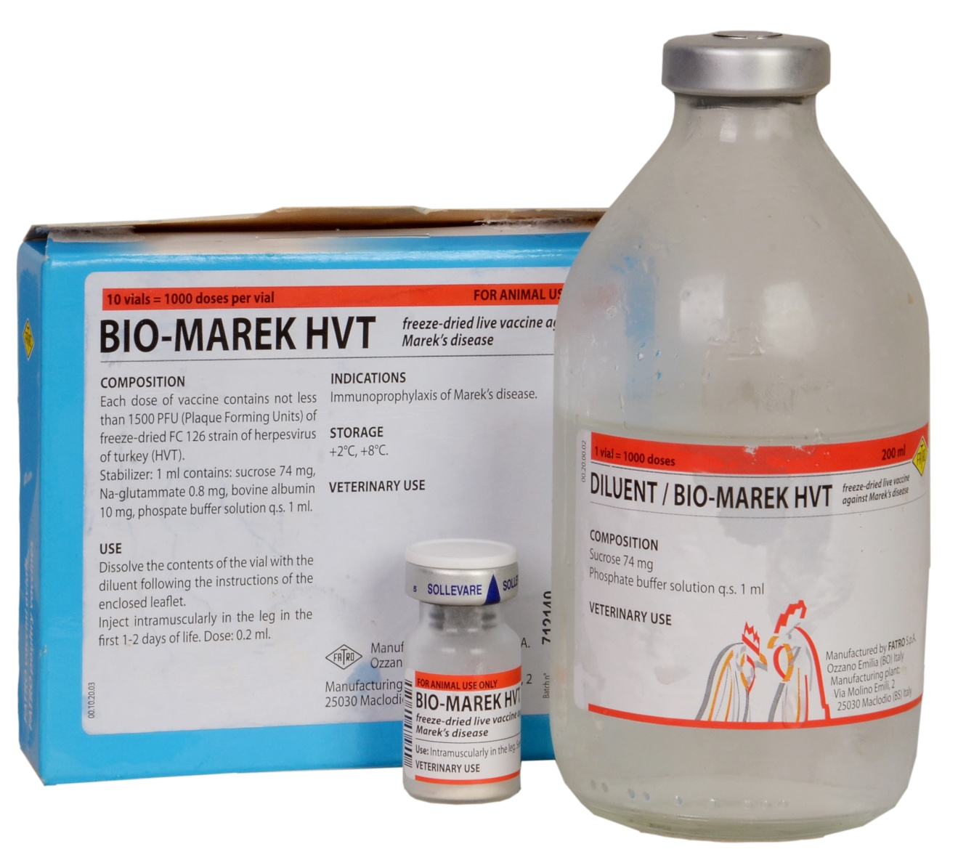
BIO-MAREK HVT (Vaccine against Mareks disease)

Slide 38
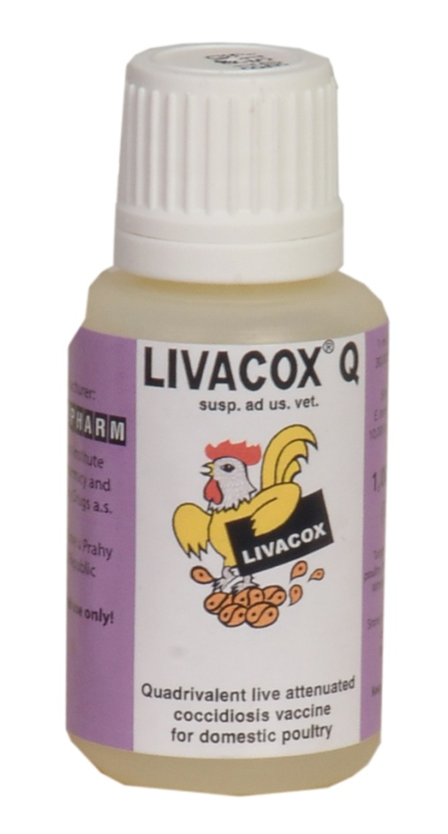
LIVACOX®Q Vaccine against coccidiosis: 1000Ds

Slide 39
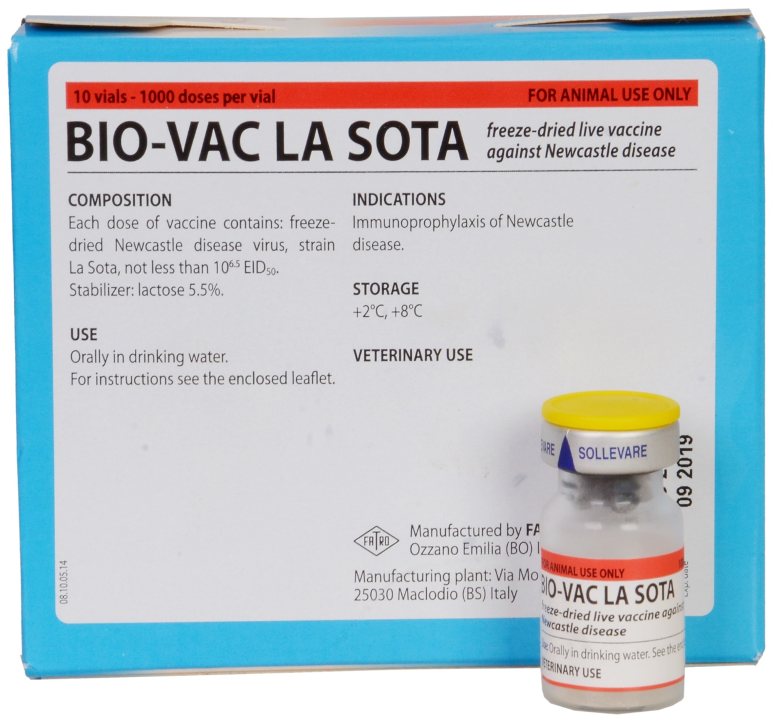
Vaccine against New Castle Disease

Slide 40
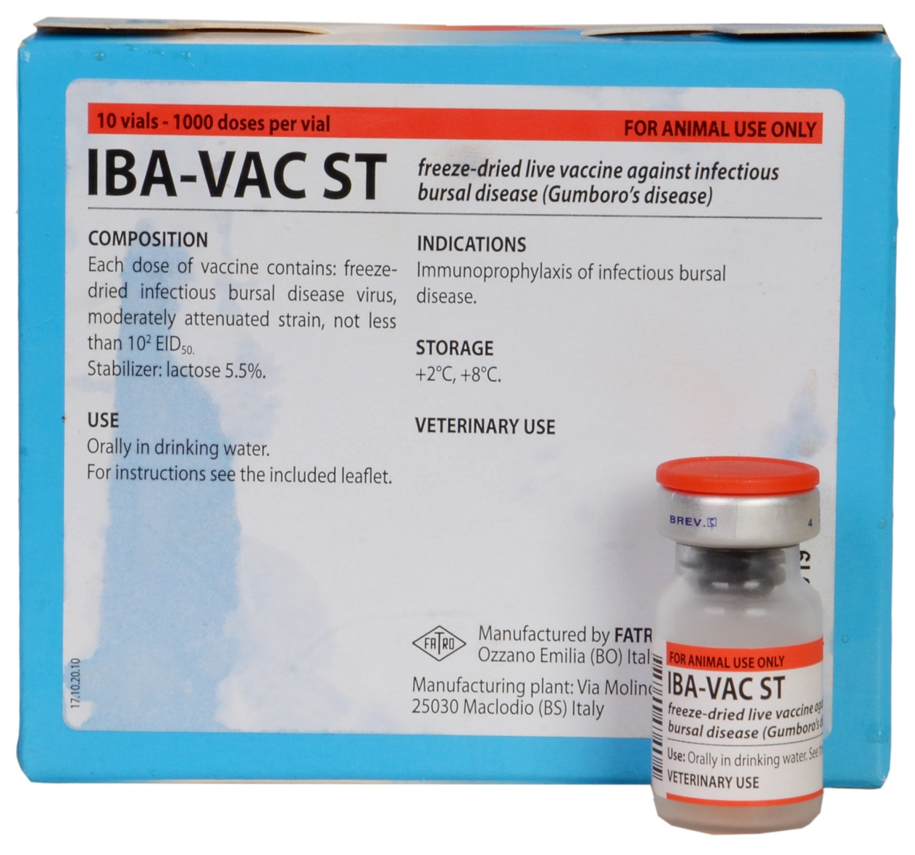
Vaccine against Gumboro disease (Infectious Bursal Disease): 1st vaccination

Slide 41
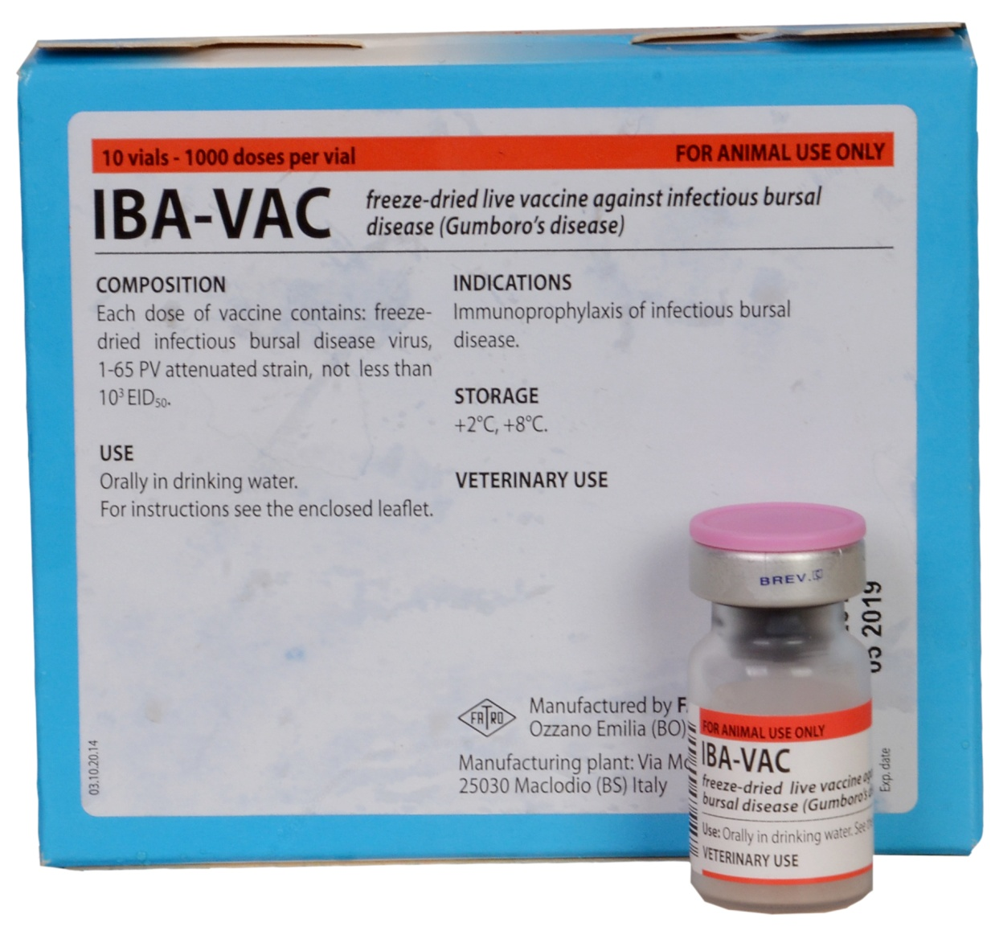
Vaccine against Gumboro disease ( Infectious Bursal Disease): 2nd vaccination

Slide 42
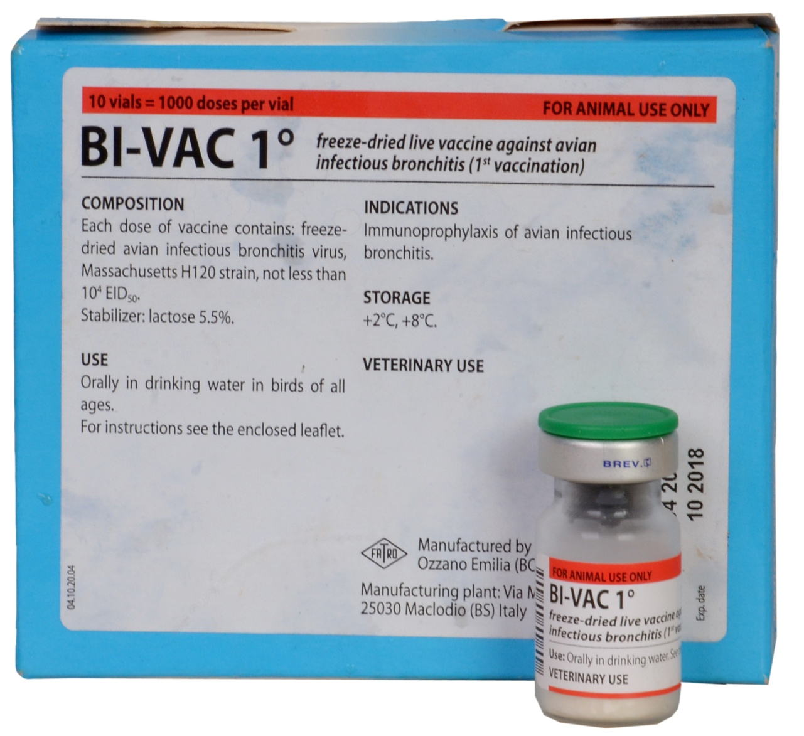
Vaccine against infectious bronchitis

Slide 43
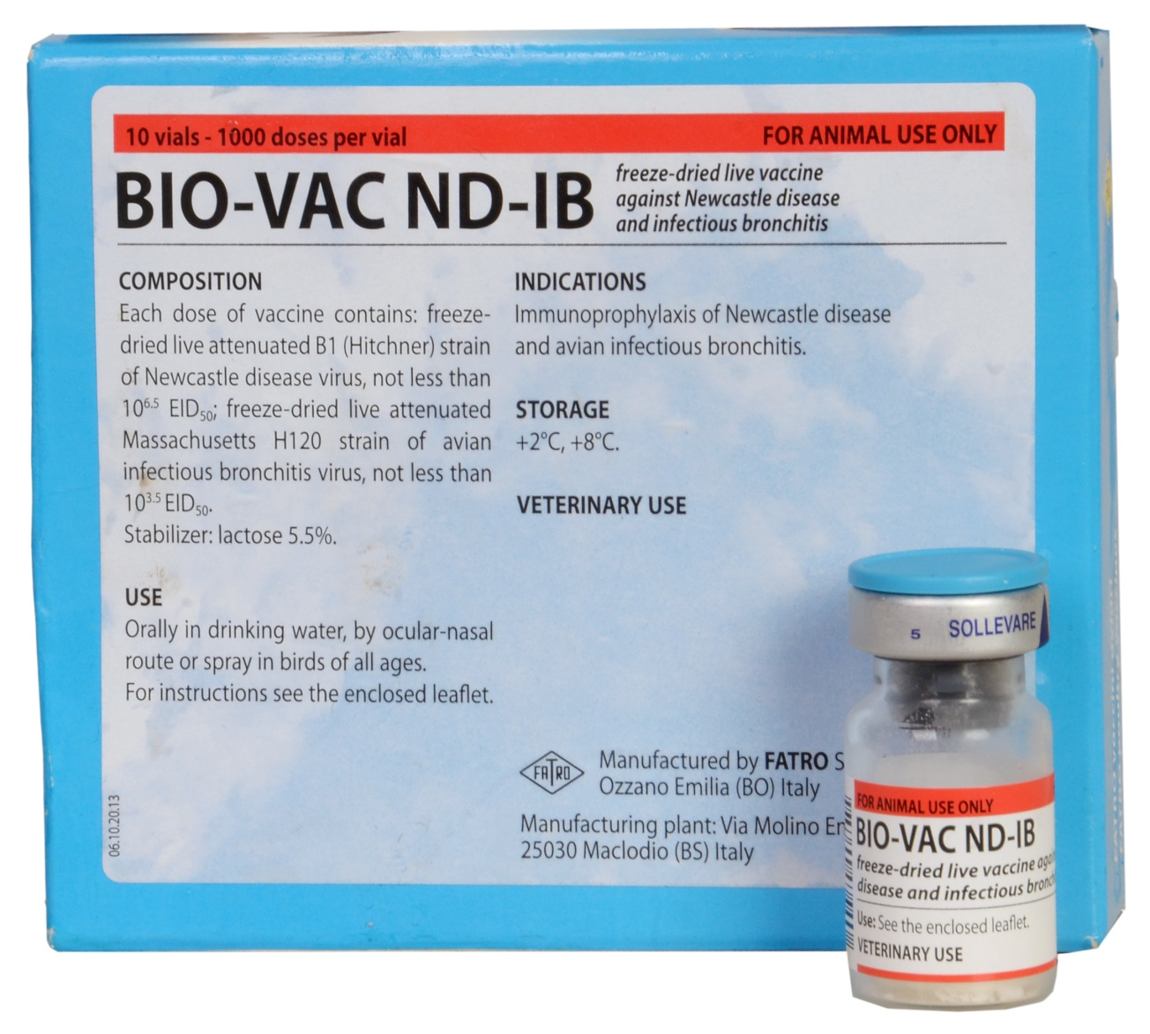
Vaccine against New Castle Disease & Infectious bronchitis(ND-IB)

Slide 44
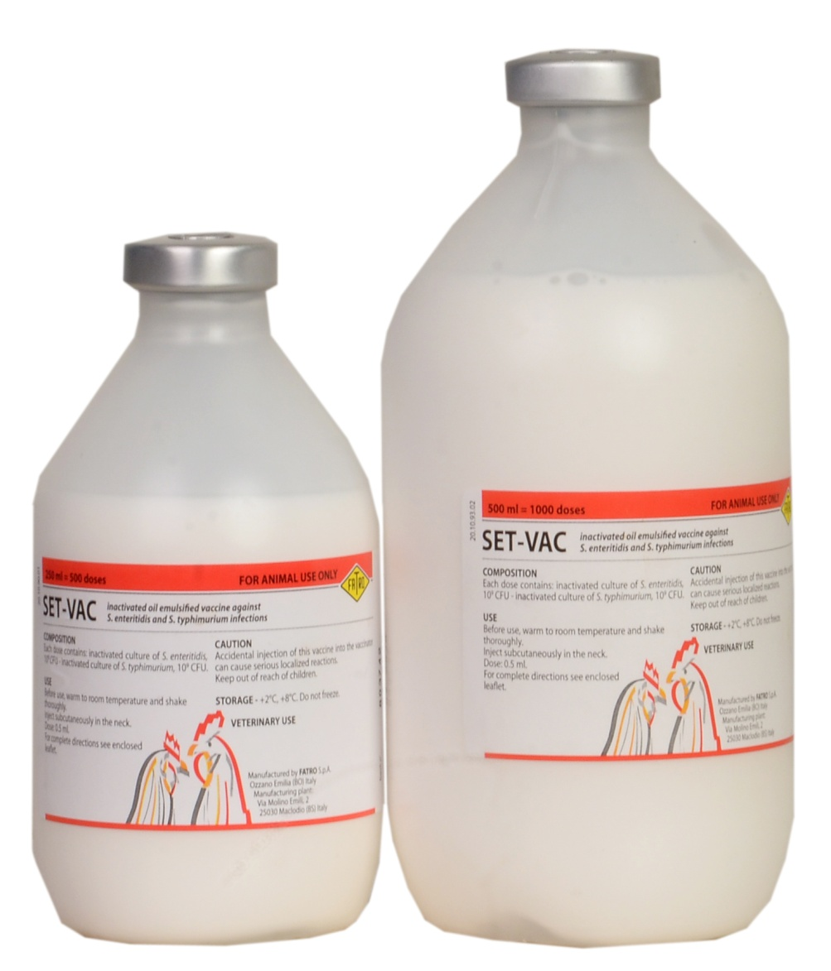
SET-VAC: Vaccine against fowl typhoid (500ds or 1000ds)

Slide 45
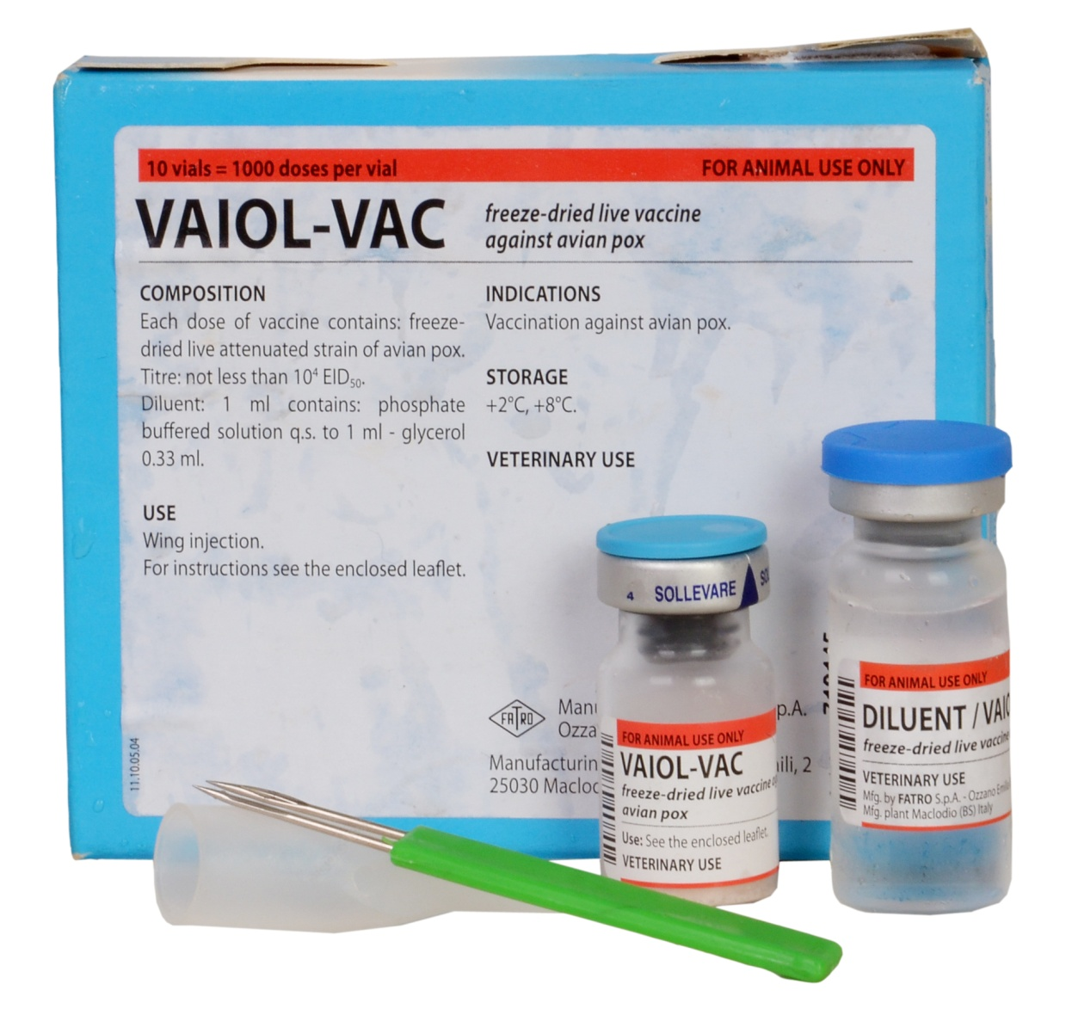
VAIOL-VAC: Vaccine against fowl pox

Slide 46
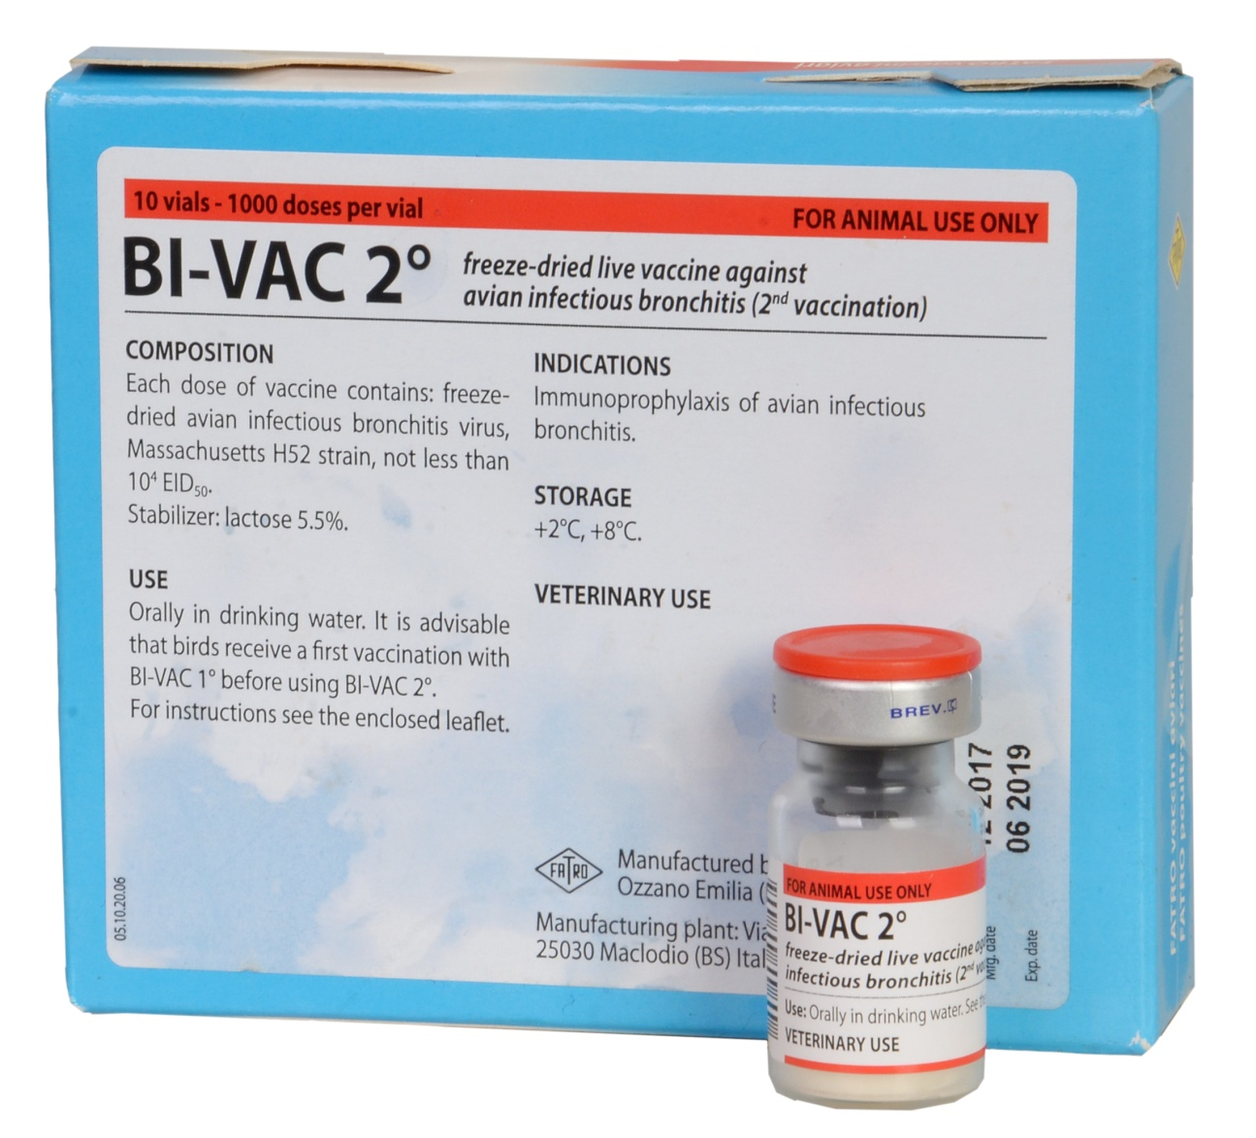
Vaccine Against Infectious Bronchitis

Slide 47
CANINE/ DOG VACCINES

Slide 48
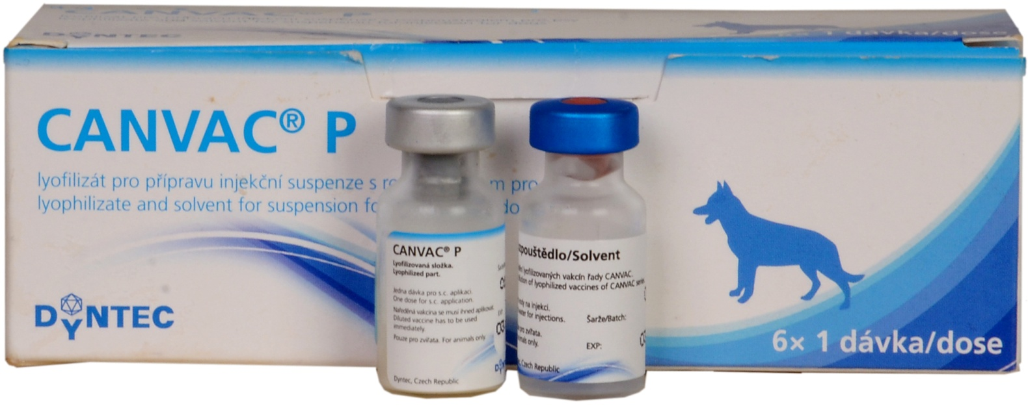
CANVAC® P: vaccine against parvovirosis

Slide 49
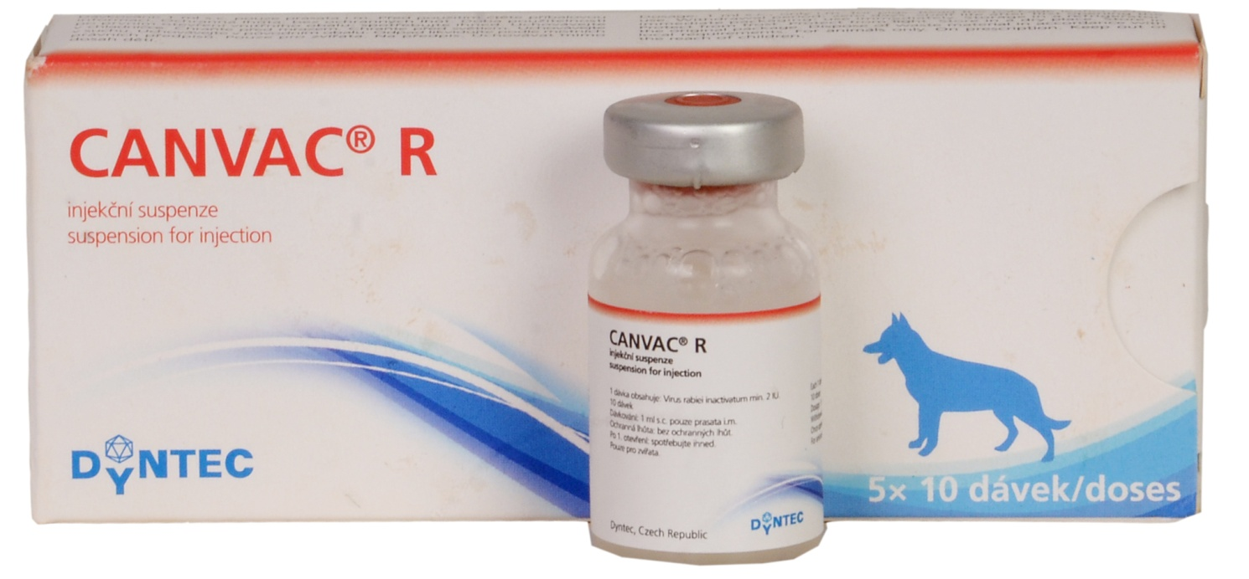
CANVAC® R: Vaccine against Rabies

Slide 50
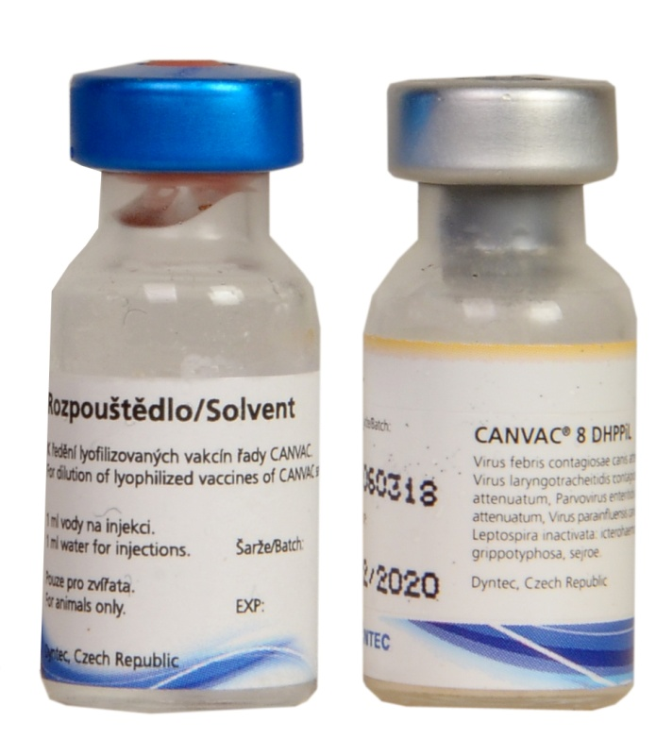
CANVAC® 8 DHPPiL: Vaccine against the 8killer diseases of canines

Slide 51
EQUIPMENT

Slide 52
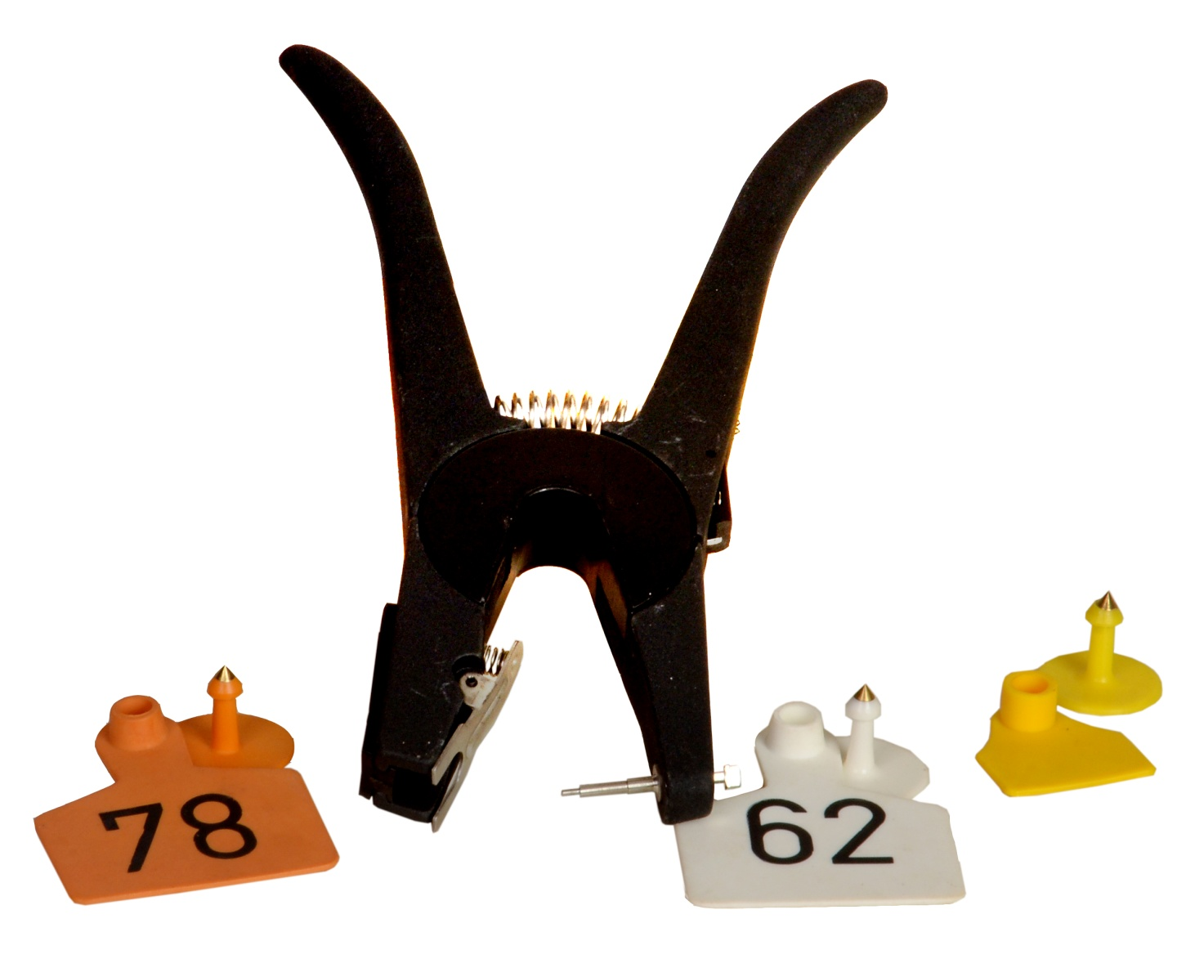
Ear tags & applicator

Slide 53
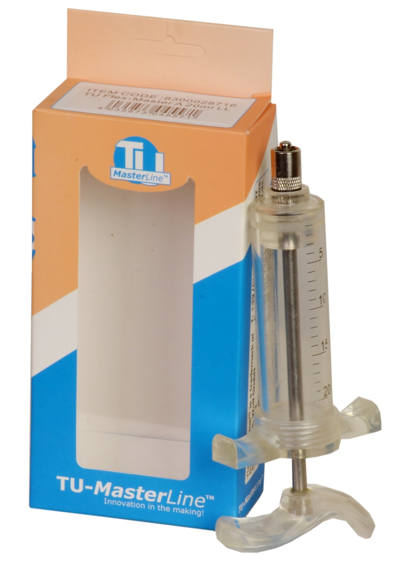
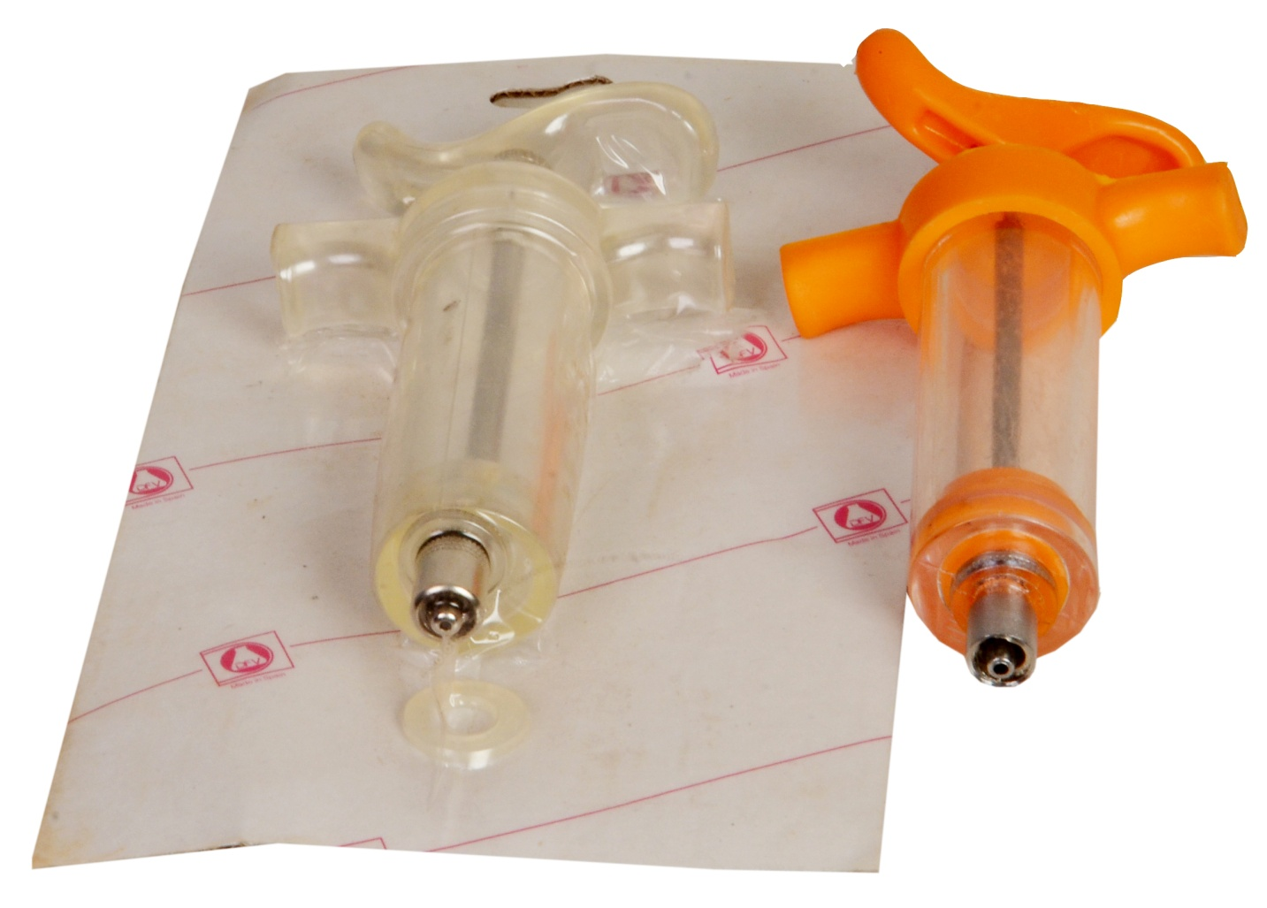
Leur Lock Hard Plastic Syringes
Hanguf
Europlex
TU-Master lineTM

Slide 54

HSW ROUX-REVOLVER® Automatic syringe: (10ml, 30ml or 50ml)

Slide 55

HSW MULTI-MATIC® Automatic Syringe: 25ml or 50ml

Slide 56

HSW ECO-MATIC® Automatic syringe: (0.3ml, 1ml, 2ml or 5ml)

Slide 57

HSW ECO-MATIC® Automatic drencher: 30ml

Slide 58

EUROPLEX® Automatic drencher: 30ml

